Slide 1
PY 2026 ESG/CDBG Training Session
June 24th - June 30th, 2025
Presented by Haley Hale, Brian Pace, and Lisa Foster

Slide 2
Introduction to the Department Of Metropolitan Development
Room 306, Civic Center Complex
1 N.W. Martin Luther King Jr. Blvd.
Evansville, IN 47708
812-436-7823
DMD Staff
Kolbi Jackson – Executive Director
Lana Abel – Deputy Director
Brian Pace – Finance Manager*
Lisa Foster – Contracts Manager*
Kory Kempf – Housing Administrator
Haley Hale – Community Development Coordinator
Gayl Killough – Community Development Specialist
Erin Phillips – Community Development Specialist
Glenn Schoenbaechler – Community Development Inspector

Slide 3
HUD Allocations: CDBG and ESG
Timeline (ONGOING)
ESG Overview
Proposals
CDBG Overview
Financial Responsibility
Monthly Monitoring Reports

Slide 4
JUNE 2025
Sun | Mon | Tues | Wed | Thurs | Fri | Sat
1 | 2 | 3 | 4 | 5 | 6 | 7
8 | 9 | 10 | 11 | 12 | 13 | 14
15 | 16 | 17 | 18 | 19 | 20 | 21
22 | 23 | 24 | 25 | 26 | 27 | 28
29 | 30
2026 CDBG/ESG GRANT TRAINING

Slide 5
JULY - AUG 2025
Sun | Mon | Tues | Wed | Thurs | Fri | Sat
29 | 30 | 1 | 2 | 3 | 4 | 5
6 | 7 | 8 | 9 | 10 | 11 | 12
13 | 14 | 15 | 16 | 17 | 18 | 19
20 | 21 | 22 | 23 | 24 | 25 | 26
27 | 28 | 29 | 30 | 31 | Aug 1 | Aug 2
Aug 3 | Aug 4 | Aug 5 | Aug 6 | Aug 7 | Aug 8 | Aug 9
2026 ESG PROPOSALS AVAILABLE
FINAL DATE FOR PROPOSAL REVIEW WITH CD STAFF
2026 PROPOSALS DUE

Slide 6
2026 Federal Grants Allocation Schedule
January 2026
March 2026
May 15, 2026
Tentative date for CAC Presentations
Tentative date for City Council Presentations
2026 Action Plan Due
2026 Program Year:
July 1, 2026 - June 30, 2027

Slide 7
HUD Allocations: CDBG and ESG
Timeline (ONGOING)
ESG Overview
Proposals
CDBG Overview
Financial Responsibility
Monthly Monitoring Reports

Slide 8
HUD RESOURCES
The City of Evansville must follow HUD Regulations in the use of CDBG funds (Subpart A 570).
Guidance and links to HUD regulations can be found at the City of Evansville, Community Development webpage.
HUD Exchange:
https://www.hudexchange.info/programs/cdbg/

Slide 9
CDBG
Benefit Low- and Moderate-Income (LMI) Persons/ Households
1
Eliminate Conditions of Slum and Blight
2
Meet a Community Urgent Need (NA)
3
National Objectives
Activities funded with CDBG must meet one of HUD’s three National Objectives

Slide 10
CDBG
National Objectives
Benefit low-and moderate-income (LMI) persons/ households
Area benefit activities
This is an activity which benefits all residents in a particular area, where at least 51% of the residents are LMI persons.

Slide 11
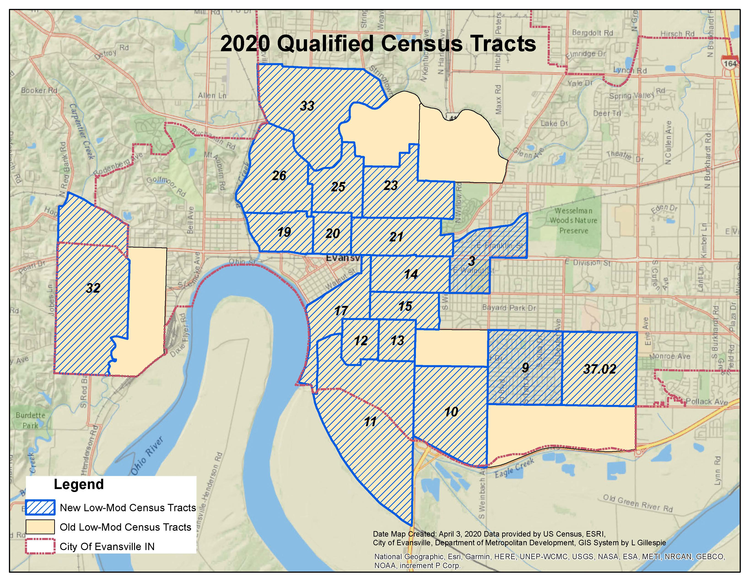
Evansville’s LMI
Census Tracts
(2020 Census)

Slide 12
CDBG
National Objectives
Benefit low-and moderate-income (LMI) persons/ households
b) Limited Clientele (LMC) 51% LMI
Presumed Benefit (LMC/PB) - Must serve certain clientele exclusively:
Abused children
Elderly (62 years or older)
Battered spouses
Severely disabled adults
Illiterate adults
Persons living with HIV/AIDS
Migrant farm workers
Homeless persons

Slide 13
CDBG
National Objectives
Benefit low-and moderate-income (LMI) persons/ households
c) Housing Benefit (LMH)
Single Family – 100% LMI
Multi-Family – 51% LMI
d) Job Creation/Retention (LMJ)
51% of jobs are taken by or made available to LMI persons

Slide 14
2025 HUD Income Guidelines
For the Evansville Metropolitan Statistical Area
Median Income – $93,900
As of June 1, 2025
Number in Household | 30% of Median (Extremely Low Income) | 50% of Median (Low Income) | 80% of Median (Moderate Income)
1 Person | $19,050 | $31,750 | $50,750
2 Persons | $21,800 | $36,250 | $58,000
3 Persons | $24,500 | $40,750 | $65,250
4 Persons | $27,200 | $45,300 | $72,500
5 Persons | $29,400 | $48,950 | $78,300
6 Persons | $31,600 | $52,550 | $84,100
7 Persons | $33,750 | $56,200 | $89,900
8 Persons | $35,950 | $59,800 | $95,700

Slide 15
CDBG - ELIGIBLE ACTIVITIES
Acquisition of Real Property
Clearance
Code Enforcement
Construction of Housing
Disposition
Homeownership Assistance
Interim Assistance
Loss of Rental Income
Microenterprise Assistance
Special Economic Development Activities
Planning and Capacity Building
Privately-Owned Utilities
Program Administration Costs
Public Facilities and Improvements
Public Services
Rehabilitation
Relocation
Special Activities by CBDOs
Miscellaneous Other Activities

Slide 16
CDBG - INELIGIBLE ACTIVITIES
The following activities may not be assisted with CDBG funds under any circumstance:
Buildings or portions thereof, used for the general conduct of government
General government expenses
Political activities

Slide 17
CDBG - INELIGIBLE ACTIVITIES
The following activities may not be assisted with CDBG funds except under the following circumstances:
authorized as Special Economic Development Activities under §570.203; or
when carried out by a Community Based Development Organization (CBDO) under the provisions of §570.204.
Purchase of equipment
Construction equipment
Fire protection equipment
Furnishings and personal property
Operating and maintenance expenses
New housing construction
Income payments

Slide 18
CDBG - SUMMARY
Eligible activities are so broad that it is easy to forget that some things cannot be done under the program!
Technical Assistance:
All activities will require an eligibility review during the proposal review process. CD Staff will provide guidance in determining the eligibility of the activities associated with housing and community development.

Slide 19
HUD Allocations CDBG and ESG
Timeline (ONGOING)
ESG Overview
Proposals
CDBG Overview
Financial Responsibility
Monthly Monitoring Reports

Slide 20
Emergency Solutions Grant (ESG)
In Evansville, there are about 500 individuals in shelter or transitional housing on any given night.
50-60 homeless individuals on the street or places not meant for habitation
More than 2,000 homeless served annually
Shelters stay at maximum capacity all year
HUD’s goal is to lessen the length of stay in shelter and move to permanent housing faster
Coordinated Entry Assessment prioritizes the homeless
Funds are meant to coordinate with other homeless funds such as Continuum of Care (CoC) funds

Slide 21
ESG - TARGET POPULATIONS
There are 4 Categories of Homelessness, according to CoC and ESG regulatory definitions:
Category 1: Literally Homeless
Category 2: Imminent Risk of Homelessness
Category 3: Homeless Under Other Federal Statutes
Category 4: Fleeing/Attempting to Flee Domestic Violence

Slide 22
ESG - REGION 12 GOALS
The Region 12 Charter, adopted on 12/14/2012, included 11 goals.
Since then, these 11 goals have been consolidated to the following:
Support the availability of public services
Support rapid re-housing
Support the coordinated entry system
Support re-entry
Homeless goals support the overall annual goals of the City of Evansville.

Slide 23
ESG
HEARTH Act, passed in 2009, stands for the Homeless Emergency and Rapid Transition to Housing Act. Emergency Solutions Grant (ESG) is authorized by the HEARTH Act.
The current interim rule of the Emergency Solutions Grant took effect January 2012.
Emergency Solutions Grant (ESG) program completely replaced the Emergency Shelter Grant program of the late 1970s. The current ESG is roughly equivalent to 60% of the old ESG.
ESG has very strict requirements. CDBG is a lot more flexible comparatively.

Slide 24
ESG
ESG Regulatory minimums and maximums:
The City estimates approximately $230,000 of ESG funds annually, based on prior allocations.
No more than $129,963 of the ESG amount may be allocated to Homeless Assistance (Street Outreach, Emergency Shelter)
Rapid Re-Housing must receive an ESG allocation each grant year; this is usually the amount remaining after Homeless Assistance programs are allocated but could be as much as 100% of the ESG budget.

Slide 25
ESG - Eligible activities
Component | Serving:
 | Those who are Homeless | Those who are at risk of Homelessness
1. Street Outreach | √
2. Emergency Shelter | √
3. Homelessness Prevention |  | √
4. Rapid Re-Housing | √
5. Administration | √ | √
Data Collection:
6. Homeless Management Information System (HMIS) (provided by IHCDA) | √ | √
Details and instructions are located at:
24 CFR 576 – Subpart B,
Program Components and Eligible Activities
(24 CFR 576.100 – 109)

Slide 26
ESG - ELIGIBLE ACTIVITIES
*Essential services must be included under the street outreach component in the interim rule to be eligible with ESG funds.
1. Street Outreach
Eligible Program Participants:
Unsheltered homeless people who are unwilling or unable to access emergency shelter, housing, or an appropriate health facility, meaning those who qualify under paragraph (1)(i) of the definition of “homeless”, which includes individuals and families with a primary nighttime residence that is a public or private place not designed for or ordinarily used as a regular sleeping accommodation for human beings, including a car, park, abandoned building, bus or train station, airport or campground.
Overview of Eligible Activities:
Essential services* to eligible participants provided on the street or in parks, abandoned buildings, bus stations, campgrounds, and in other such settings where unsheltered persons are staying. Staff salaries related to carrying out street outreach activities are also eligible.

Slide 27
ESG - ELIGIBLE ACTIVITIES
2. Emergency Shelter
Eligible Program Participants:
Categories 1-4 of the Homeless definition.
Eligible Activities:
Essential services to persons in emergency shelters, renovating buildings to be used as emergency shelters, and operating emergency shelters.
Staff costs related to carrying out emergency shelter activities
Costs to operate and maintain emergency shelters and provide other emergency lodging when appropriate.
ESG funds may be used for day shelter if it meets the definition of a shelter §576.2.

Slide 28
ESG - ELIGIBLE ACTIVITIES
3. Homeless Prevention (no longer applicable)
4. Rapid Re-housing
Homeless Definition:
Categories 1-4 of the Homeless definition. Individuals and families must have an income at or below 30% AMI at annual re-evaluation.
Overview of Eligible Activities:
Short- and medium-term rental assistance and housing relocation and stabilization services. Eligible expenses may also include staff salaries related to carrying out rapid re-housing.

Slide 29
ESG Match
24 CFR 576.201 contains match requirements
Each ESG subrecipient, must match funding provided with an equal (1:1) amount of funds from other sources.
Matching funds must be related to expenditures occurring after the date of the grant award. Funds used to match a previous ESG grant may not be used to match a subsequent grant award.
In general, matching funds provided may consist of:
amount of funds from other sources;
salary paid to staff (not included in the award) to carry out the project of Grantee;
the value of any donated material or building, or of any lease, calculated using a reasonable method to establish a fair market value;
time contributed by volunteers; and
matching funds or voluntary efforts provided by any recipient or project sponsor.

Slide 30
HUD Allocations CDBG and ESG
Timeline (ONGOING)
ESG Overview
Proposals
CDBG Overview
Financial Responsibility
Monthly Monitoring Reports

Slide 31
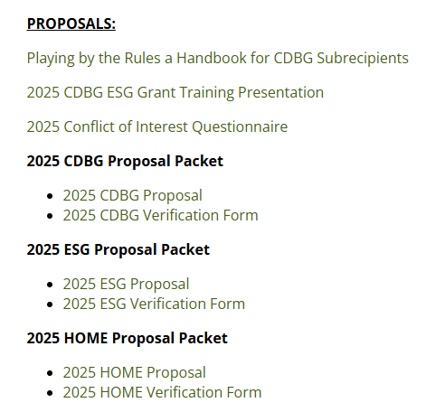
PROPOSALS
The 2026 ESG and CDBG proposal packets will be available on the City of Evansville, Community Development website by July 1, 2025, at the link below:
www.evansville.in.gov/cdfederalprograms

Slide 32
PROPOSALS
Both the ESG and CDBG Proposals are divided into 4 sections:
General Information
Project Information
Financial Information
Affiliations and Board of Directors Information

Slide 33
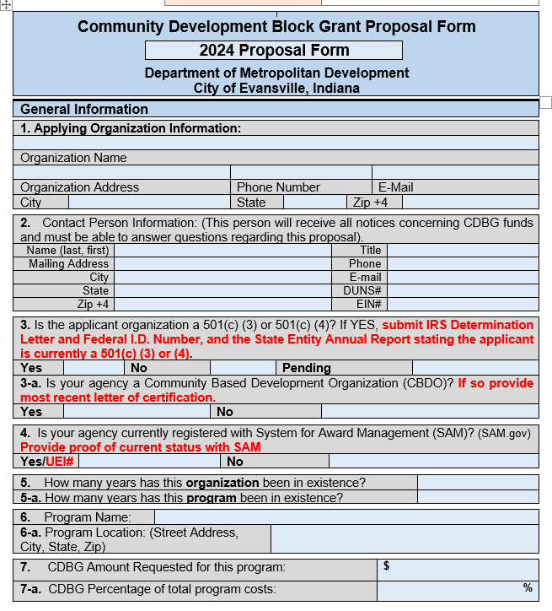
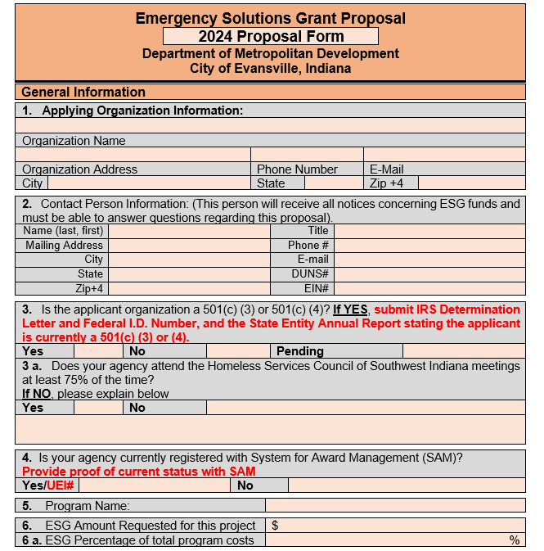
PROPOSALS

Slide 34
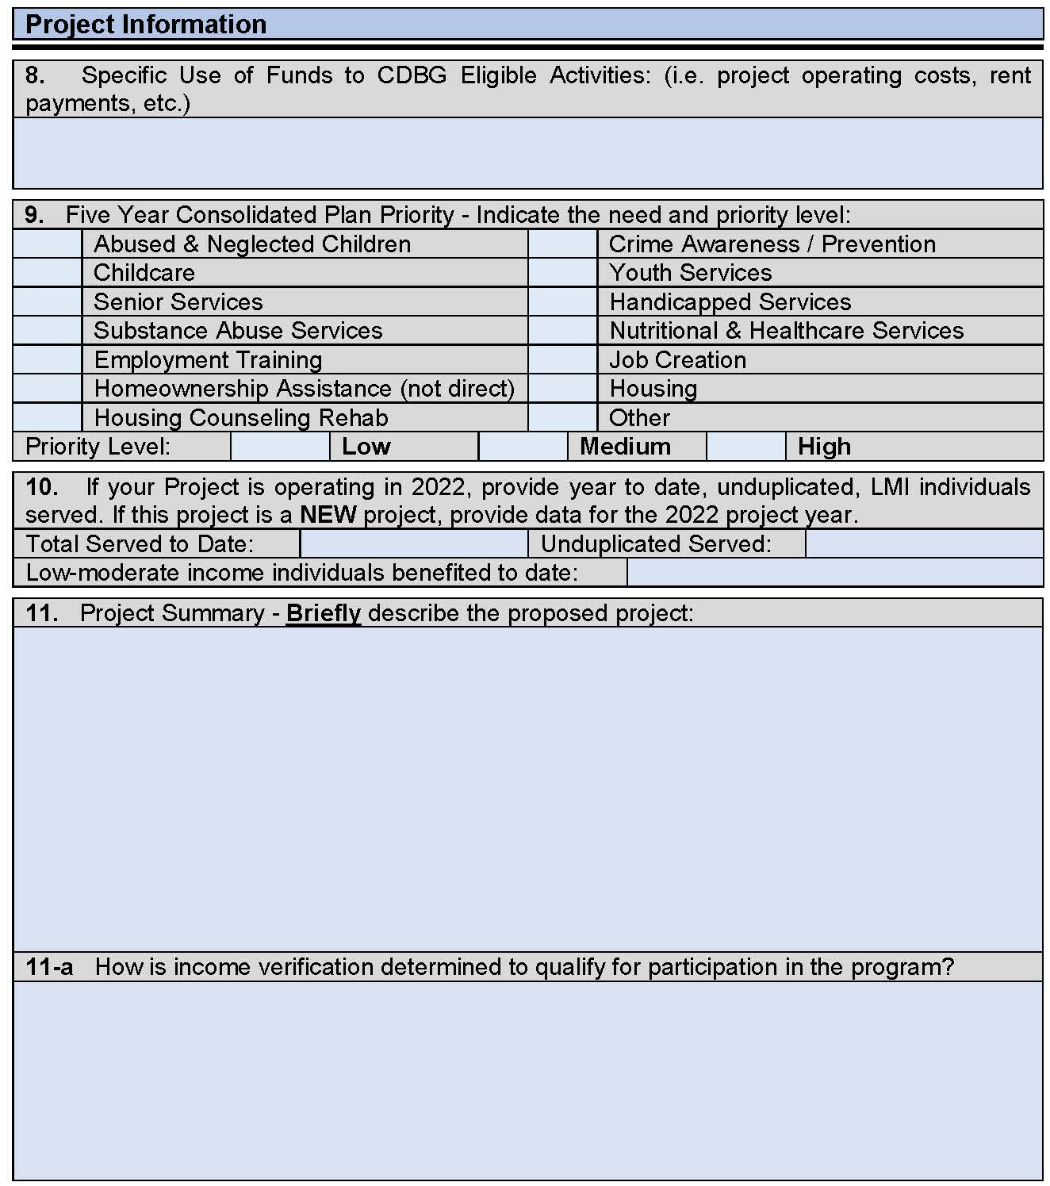
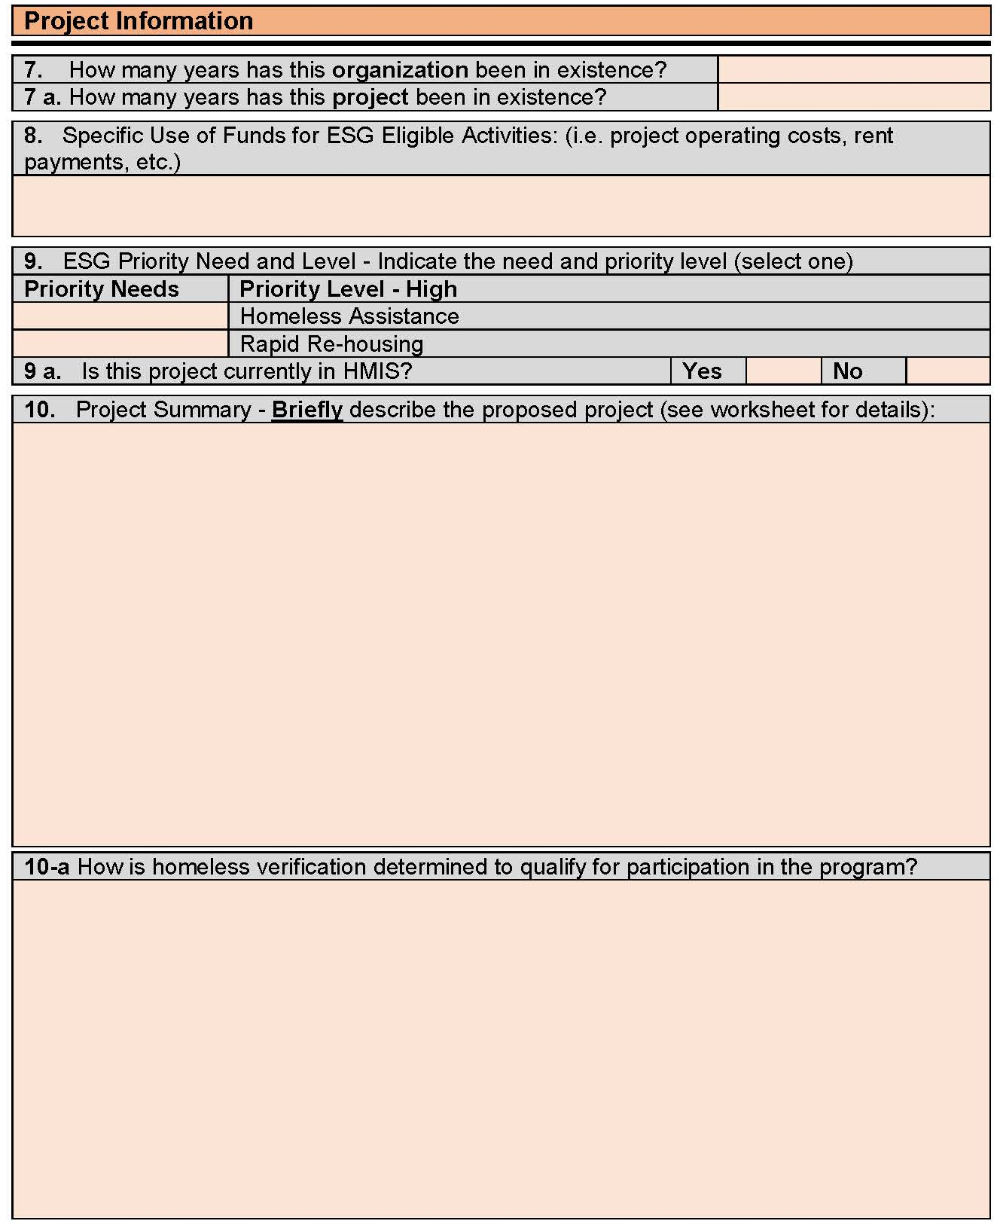
PROPOSALS

Slide 35
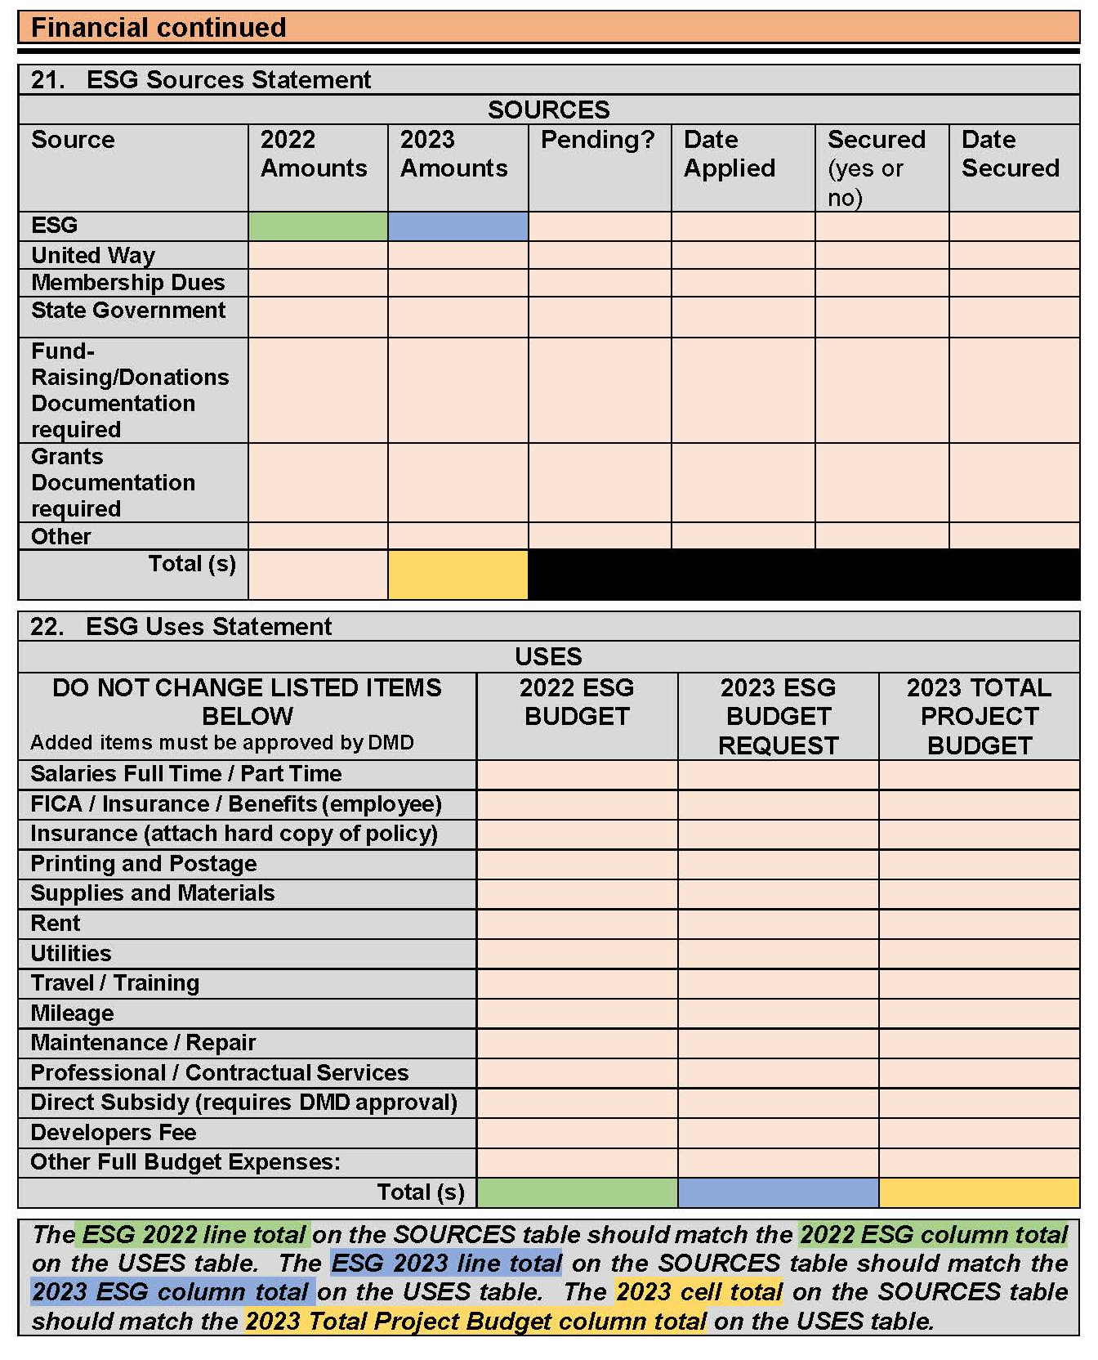
PROPOSALS
Sources = Uses

Slide 36
Proposals
There are several additional documents that must be submitted with each grant proposal, including two DMD-supplied forms:
Proposal Verification Page – original signature required
Conflict of Interest Questionnaire – see next slide
THE DOCUMENTS LISTED ABOVE WILL BE AVAILABLE ON THE CITY WEBSITE AS OF JULY 1, 2025

Slide 37
CDBG; § 570.611
ESG; § 576.404
HOME; § 92.356
CONFLICT OF INTEREST
(see and sign the SOP)
Conflicts of Interest occur when a federal grant subrecipient:
directly or indirectly benefits financially or otherwise by the activities carried out using grant funds.
participates in the decision-making (allocation) process and may obtain financial interest or benefit from an activity, have a financial interest in any contract, subcontract, or agreement, either for themselves or immediate family member or business ties.
Conflicts exist both during tenure and for one-year after.
Conflict of Interest Provisions vary by funding source. Your CD Specialist will further discuss these standards in the proposal review stage. However, it is each agency’s responsibility to properly report real and potential conflicts to DMD.

Slide 38
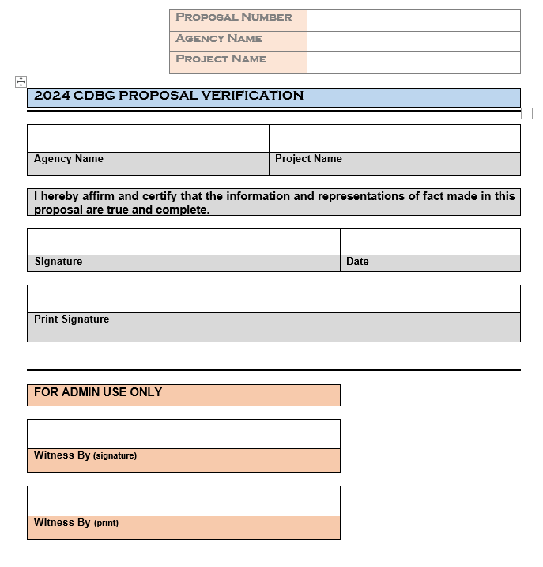
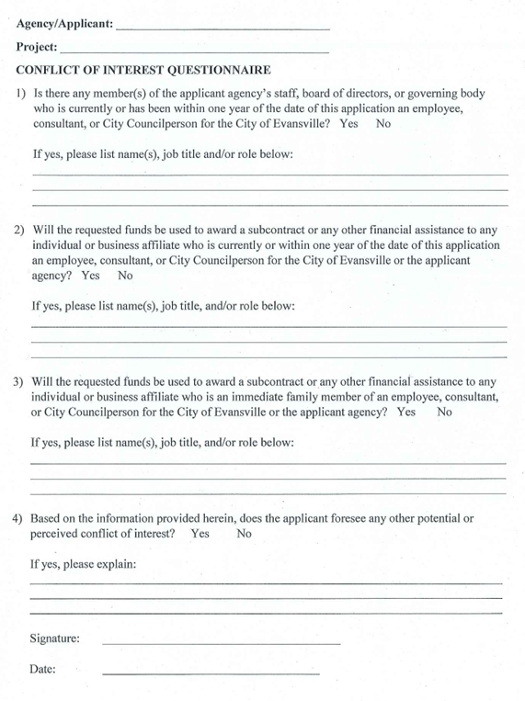
PROPOSALS

Slide 39
Summary of REQUIRED ATTACHMENTS
Current 501 C (3) or 501 C (4) Documents
CBDO Certification letter (if applicable)
Most recent Audit report
Resumes, job descriptions, etc….
Current MOU’s (if applicable)
Complete List of Board Members
Policy and Procedures for Board Member participation
Conflict of Interest Statement
Proposal Verification

Slide 40
Proposal submittal process
Attendance at proposal training session is mandatory
Proposals available on City website by July 1st www.evansville.in.gov/cdfederalprograms
Complete an initial draft of the proposal(s) and schedule proposal review appointment with assigned CD Specialist
After the proposal review appointment with CD Specialist, make edits as needed
Submit editable Word format ONLY copy of proposal via email to CD Specialist
Include all supporting documentation as required with final proposal
Deliver final, signed copy of proposal with $20.00 fee for each proposal submitted to DMD, Room 306 Civic Center Complex by 4:00 PM on August 8th
Checks required, no cash or personal checks
Checks to be made out to the Department of Metropolitan Development (please include a description in memo line)
Application fee is NOT reimbursable

Slide 41
JULY - AUG 2025
Sun | Mon | Tues | Wed | Thurs | Fri | Sat
29 | 30 | 1 | 2 | 3 | 4 | 5
6 | 7 | 8 | 9 | 10 | 11 | 12
13 | 14 | 15 | 16 | 17 | 18 | 19
20 | 21 | 22 | 23 | 24 | 25 | 26
27 | 28 | 29 | 30 | 31 | Aug 1 | Aug 2
Aug 3 | Aug 4 | Aug 5 | Aug 6 | Aug 7 | Aug 8 | Aug 9
2026 ESG PROPOSALS AVAILABLE
FINAL DATE FOR PROPOSAL REVIEW WITH CD STAFF
2026 PROPOSALS DUE

Slide 42
HUD Allocations CDBG and ESG
Timeline (ONGOING)
ESG Overview
Proposals
CDBG Overview
Financial Responsibility
Monthly Monitoring Reports

Slide 43
Up Next: Financial Responsibility
Finance Manager, Brian Pace
Contract Manager, Lisa Foster
Overview
Vendor Self-Service
SAM Registration
Claims process
Example of claim packet
Common issues with claim submissions
Monthly monitoring reports
Timeliness
Reconciliation responsibilities
Audits

Slide 44
Overview
The City of Evansville follows Indiana State Board of Accounts guidelines for accounts payable processing.
Agencies (Subrecipients), must comply with the Office of Management and Budget Guidance (Code of Federal Regulations) at 2 CFR Part 200, the “Uniform Administrative Requirements, Cost Principals, and Audit Requirements for Federal Awards”
HUD expects that Subrecipients will comply with all applicable Federal requirements, document their performance, and follow effective accounting and management practices.
Simply stated, federal and state requirements specify how DMD can disburse these funds. DMD and all Subrecipients of these funds are required to follow these regulations.

Slide 45
Vendor Self-Service
Every grant recipient must have an active Vendor Self Service Account with the City of Evansville
If you are already set up, please log in and make sure your account information is accurate
Vendor Self Service Set-up
Required documents must be uploaded to Vendor Self-Service
IRS Form W-9
Conflict of Interest Form

Slide 46
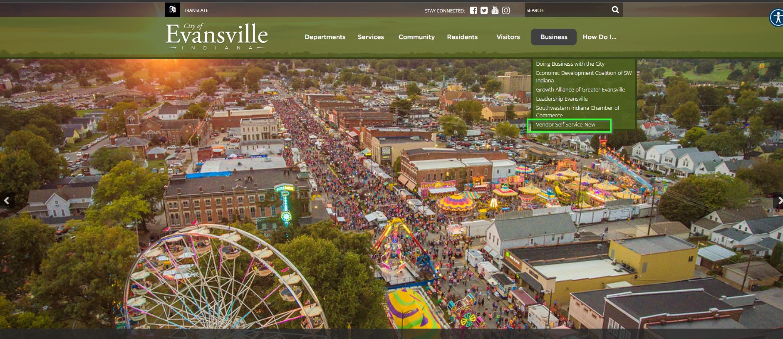

Slide 47
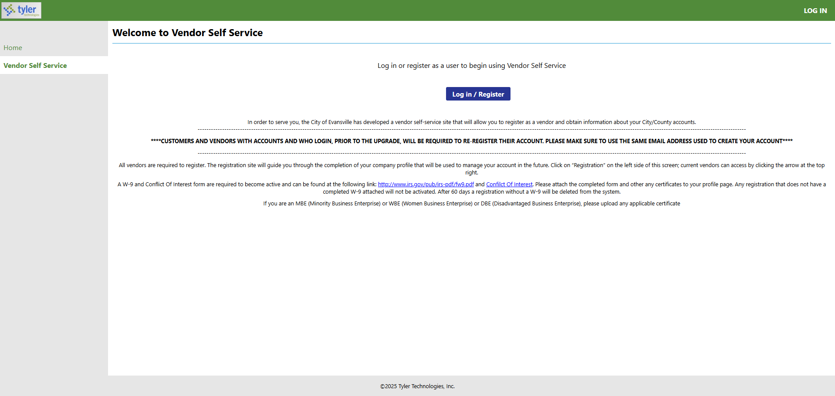

Slide 48
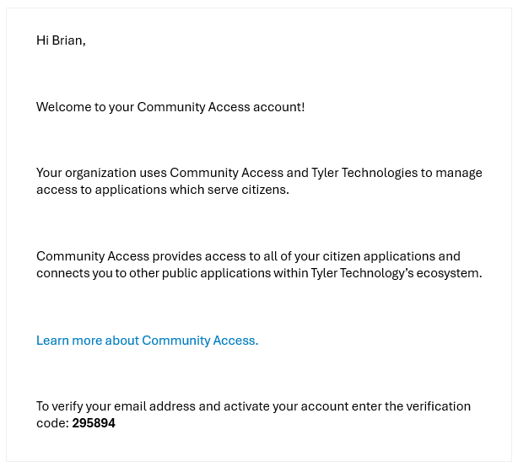

Slide 49
Step 1

Slide 50
Step 2
*can be skipped*

Slide 51
Step 3

Slide 52
Step 4
*can be skipped*

Slide 53
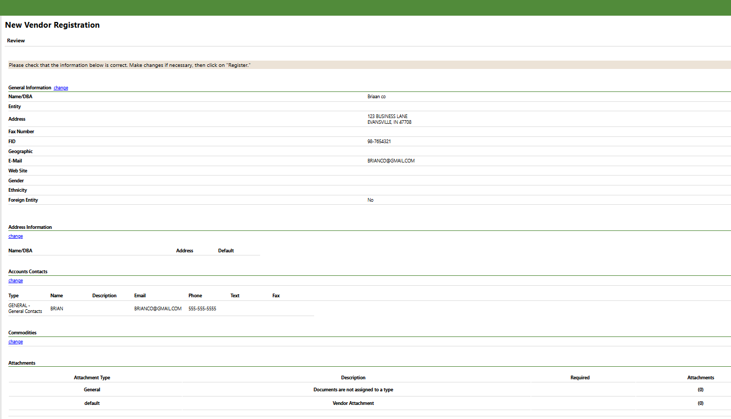
Step 5
Please check that the information below is correct. Make changes, if necessary, then click “Register.”

Slide 54
Step 5 continued
Attach the W-9 and Conflict of Interest Form

Slide 55
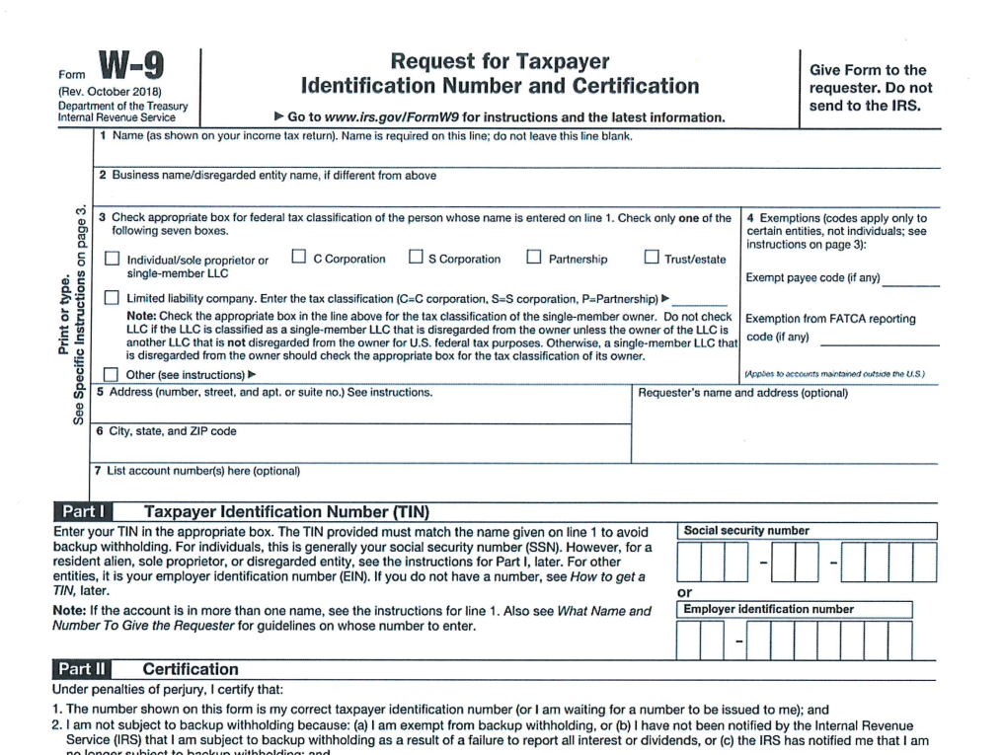
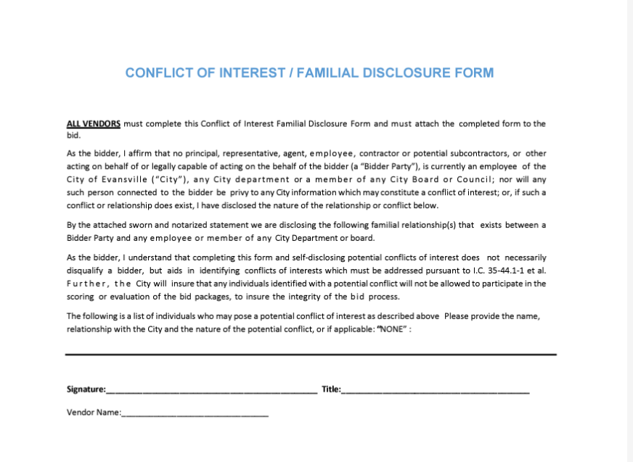

Slide 56
SAM Registration
Registration in SAM.gov is required for any contractor, organization, or individual desiring to do business with the government.
With this registration, you are allowed to bid on government contracts and apply for federal assistance.
Registration must be renewed yearly for it to remain active.

Slide 57
SAM Registration
Reimbursement will not be approved if SAM registration is inactive.
Upon registration, you will be assigned a Unique Entity ID number (UEI), which is required for all contracts with The City of Evansville. UEI has replaced the DUNS Number; some agencies may have both forms of identification, but only the UEI is needed.
When registering, make sure that you mark your information “for public display.” This will not include any private account information. If this option is not checked, we cannot verify your eligibility, and it may not be visible to others looking for registered contractors.

Slide 58
Claims Process
As part of the proposal process, an agency must submit a budget for approval. Budgets contain the anticipated amount and type of expense requested for reimbursement. Please be specific. This is an Exhibit for the executed agreement between your agency and the City.
Once your budget and the agreement is approved, you will receive at minimum:
A Notice to Proceed letter
A Purchase Order (PO)
An Invoice Template (Invoice Cover Sheet)
A copy of the executed Agreement
You may begin submitting claims for expenses incurred during the period specified in the agreement (typically, the program year). Unbudgeted expenses included in a submitted claim will not be paid until a revised budget is submitted and approved by DMD.

Slide 59
How to Submit Claims for Reimbursement
(see the handout for full Exhibit)

Slide 60
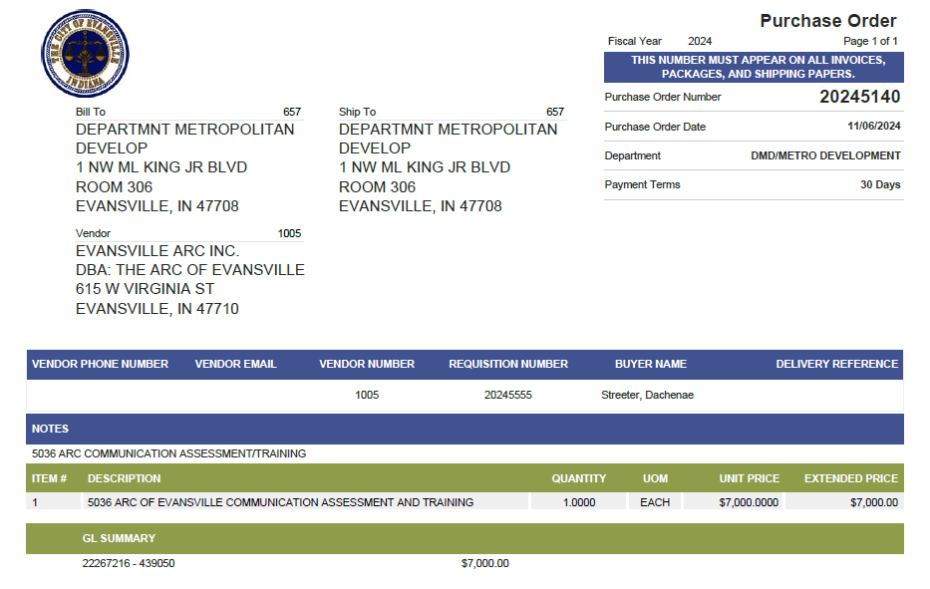
Example of a
Purchase Order

Slide 61
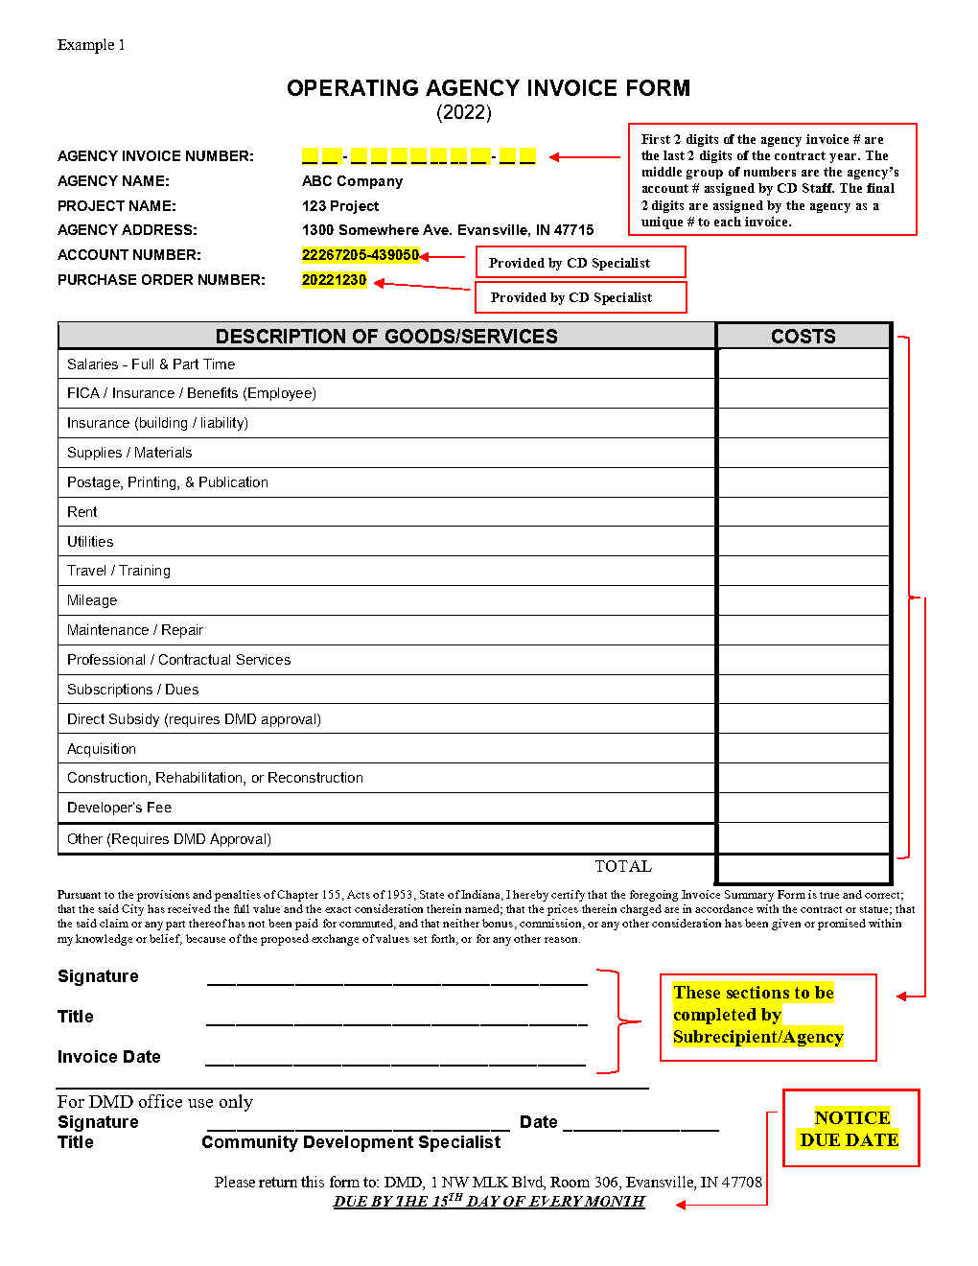
Example of an Invoice Form
(Cover Sheet)

Slide 62
Summary Sheet
A summary sheet is a spreadsheet that the agency prepares with a breakdown of each expense and its corresponding proof of payment (i.e. a check or bank/ACH statement). It further organizes and details the line items of the cover sheet. It makes clear what calculations occurred to result in the claim submitted.
For expenses like supplies or contractual services, please assign an identifier to each expense and record that number on the supporting documents (such as the vendor’s invoice and check copies).
For salaries, show the total hours worked for the pay period (including any non-program hours) and total program hours claimed with the hourly wage for claimed hours per employee. These should also be marked with an assigned identifier.

Slide 63
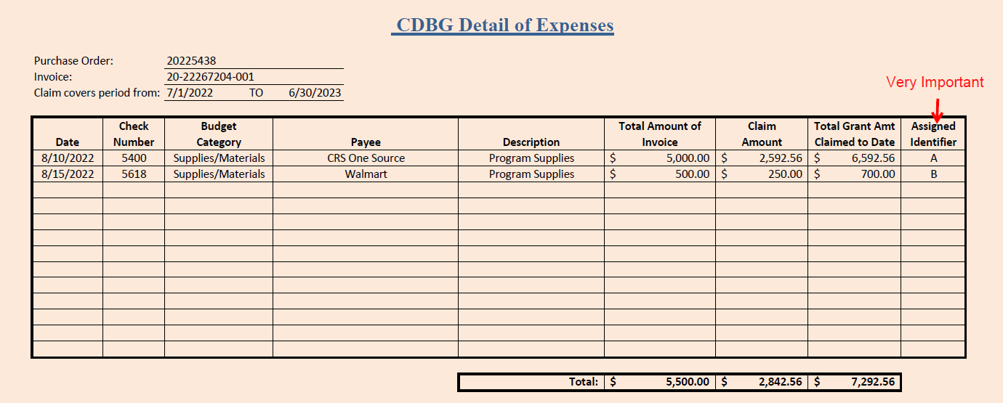
Expense summary sheet example
Total should match the cover sheet
Enter date range here, preferably claiming monthly

Slide 64
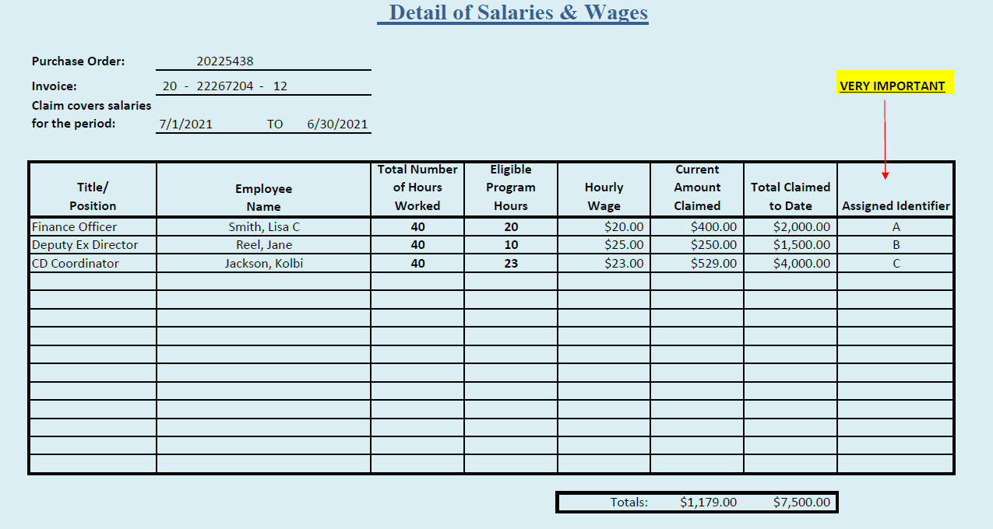
Salary summary sheet
Enter pay period here
If the amount being claimed is less than the total eligible, please indicate that by adding columns

Slide 65
Source documentation for expenses
Vendor invoices & receipts must include:
Date of invoice
Date(s) of service
Total invoice amount
Amount claimed with ESG/CDBG (if different than the total invoice amount)
Assigned identifier, clearly marked

Slide 66
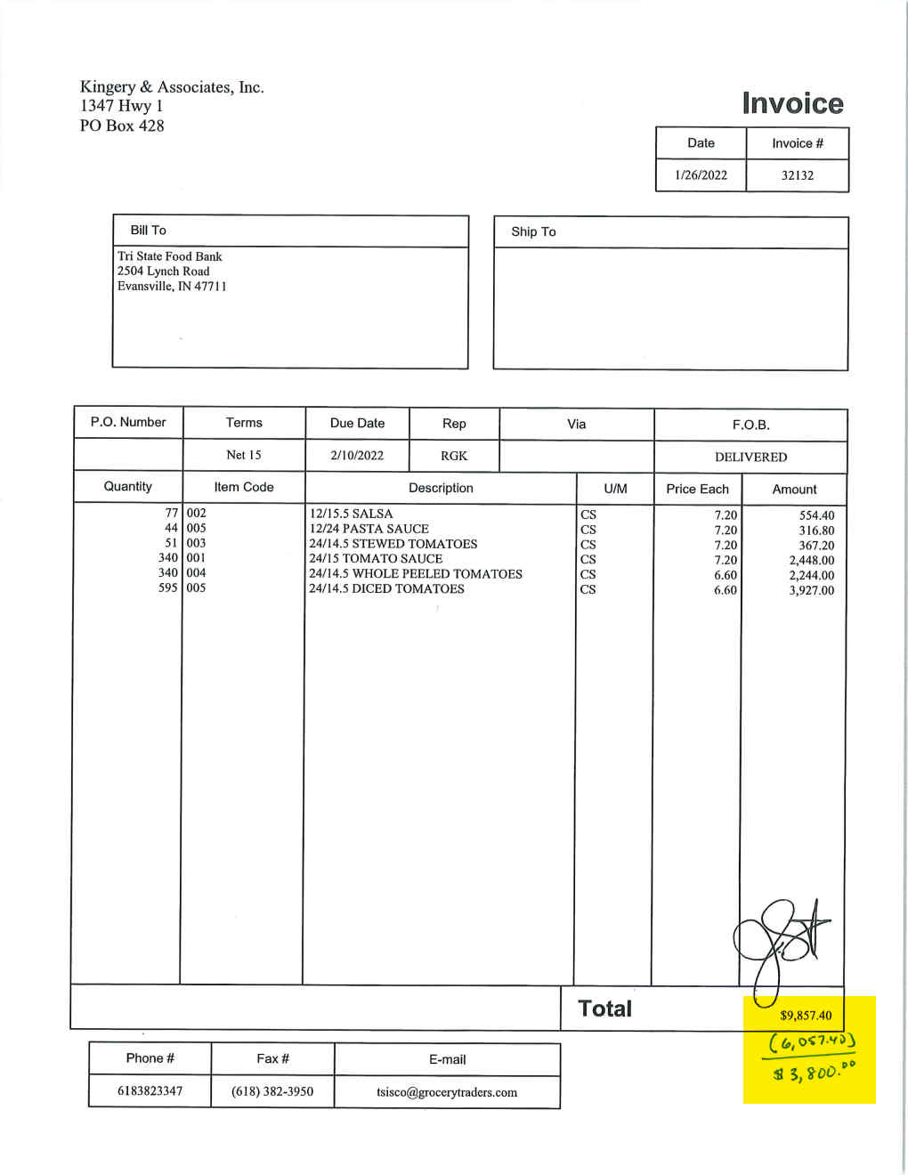
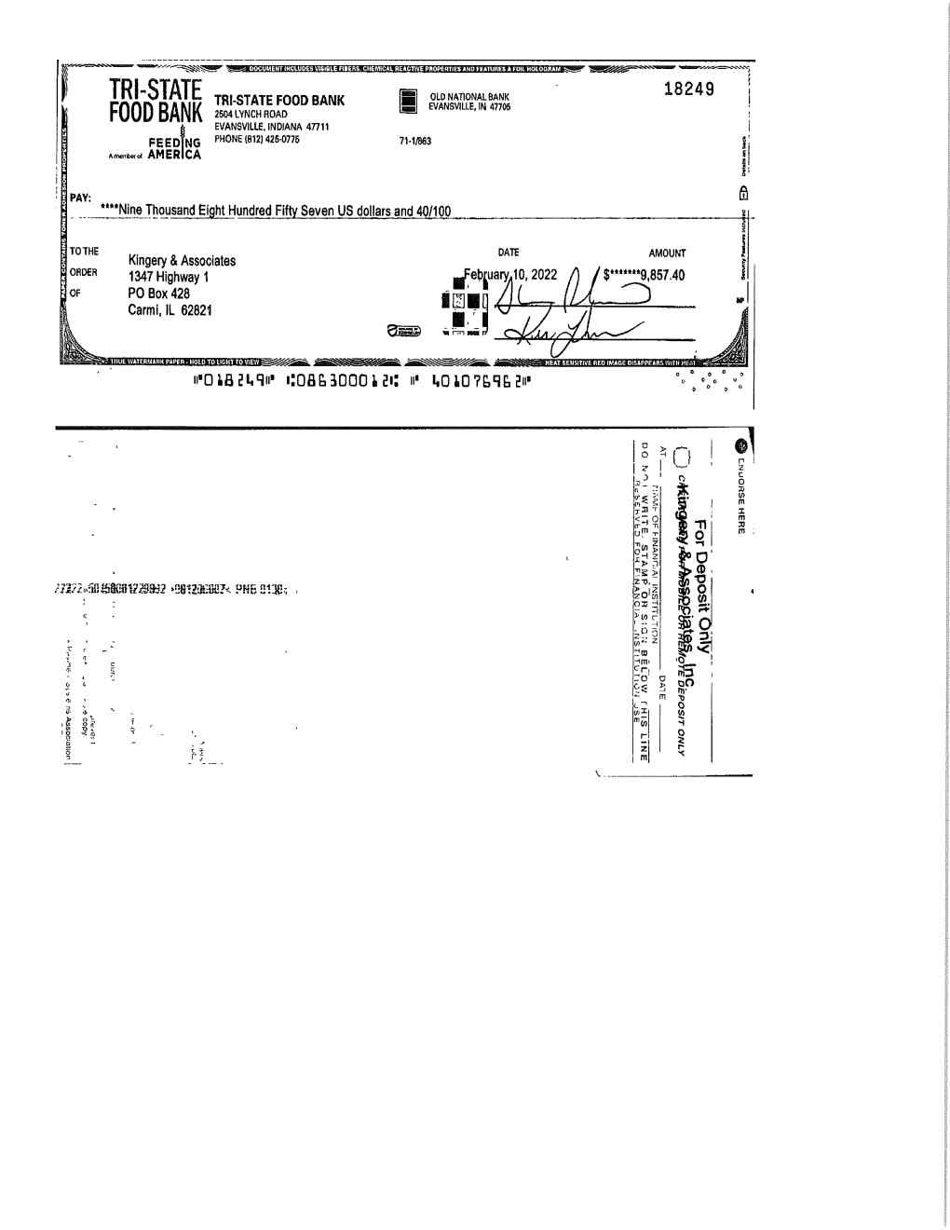
A
Example of vendor invoice with canceled check
A

Slide 67
Payroll Source Documentation
Two payroll documents are required to claim employee salaries…
Timecards must:
Be signed by employee and supervisor (HUD requirement)
Show total time worked
Provide additional time tracking documentation, for any employee who works on multiple programs (avoids claiming duplicated hours)
Payroll journals and reports must show:
Employee hourly amount
Pay periods
Pay dates
Check number or ACH transaction number

Slide 68
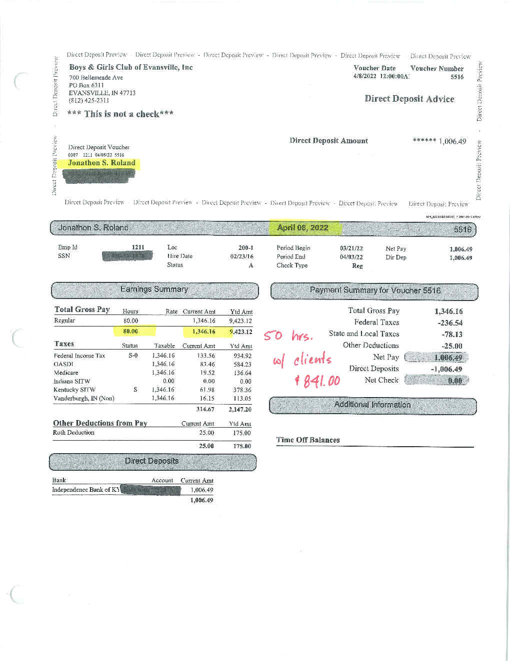
Example of payroll claim submission
A

Slide 69
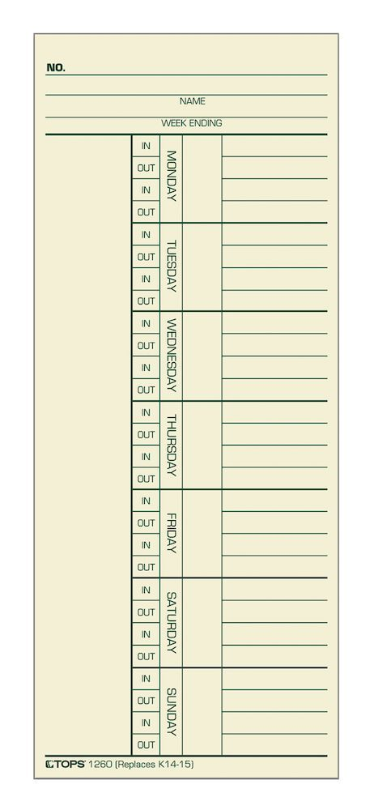
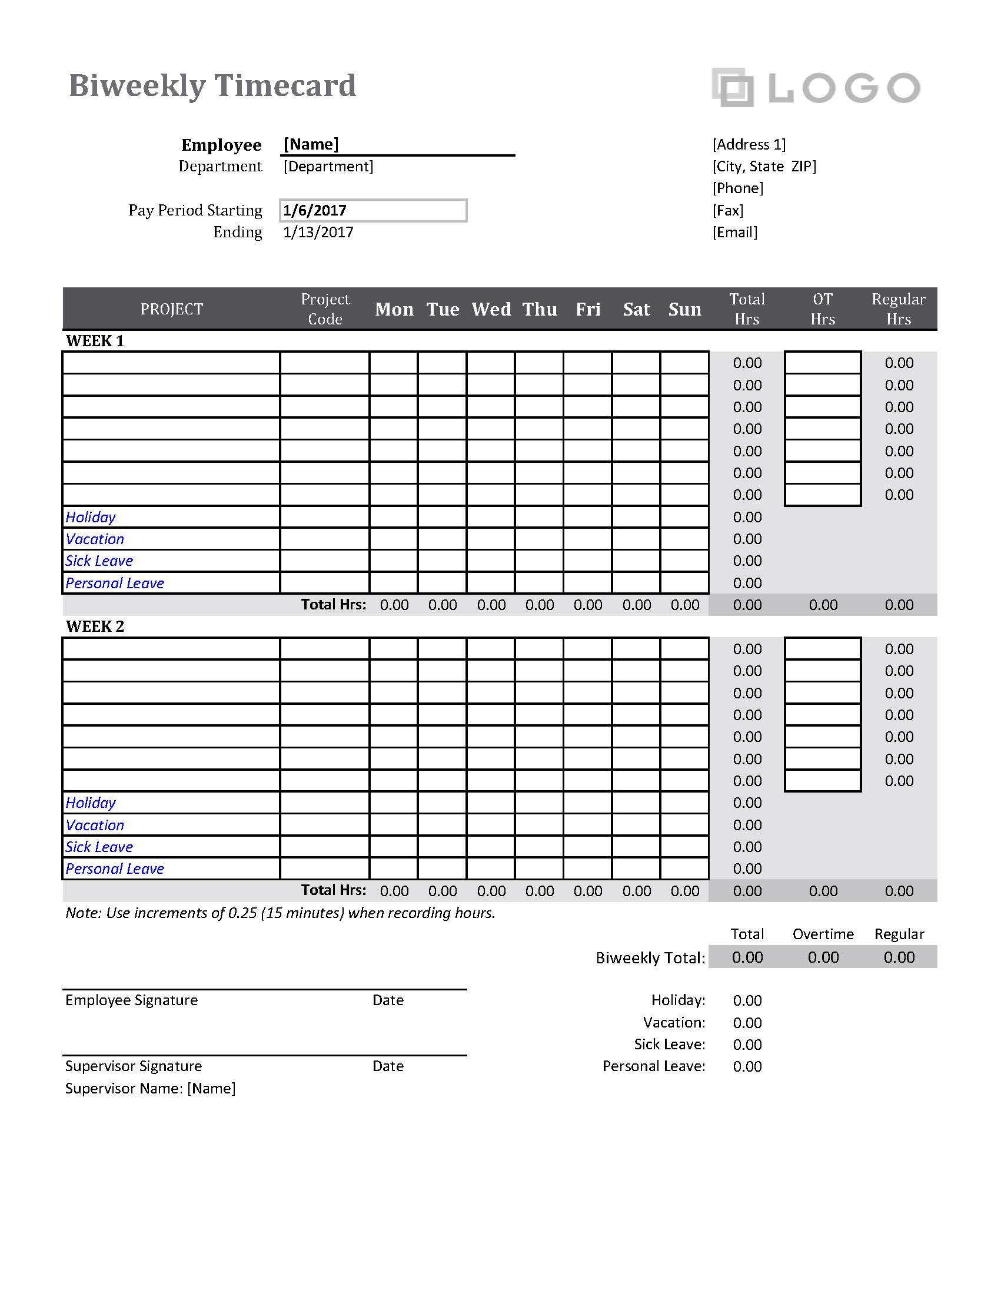
Examples of Timecards

Slide 70
Proof of Funds Expended
Copies of canceled checks, front and back.
OR
Copy of bank statement - including 1st page with agency name legible. Cancelled check or ACH withdrawal highlighted.
If the expense is paid by credit card, a copy of the credit card statement and canceled check paying credit card bill are required.
Please label the check or ACH entry with the assigned identifier.
Redact any non-public information: Social Security numbers, date of birth, addresses of employees, etc.

Slide 71
Common issues with claim submissions
Insufficient Monthly Monitoring Reports (MMR) to back up claim submissions. We must have a record of grant accomplishments to pay claims.
Documentation is insufficient for approval. Please make sure all source documentation for eligible expenses is included in the submission.
Ineligible expenses claimed. Only items listed in your submitted and approved budget are eligible for reimbursement. Application fees, late fees, finance charges, and sales taxes for non-profits are not eligible for reimbursement.
Confidential information not redacted – ex. birthdates, Social Security numbers, employee addresses, and bank account numbers.

Slide 72
Common issues with claim submissions
Documentation not in a logical order, based on the operating agency invoice form and summary sheet. All source documents must be in the order of summary sheets so that they can be quickly and easily verified by multiple people as the claim packet moves through the approval process.
Claim submissions that are double-sided and/or stapled. Please submit single-sided documents only. Please do not staple documents; all documents are digitized before processing.
Errors on the cover form (such as duplicate invoices, invoice date not current or for a future date, or incorrect claim total)
Math errors – expenses that are improperly calculated

Slide 73
Monthly Monitoring Reports (MMR)
Monthly Monitoring Reports are critical in the grant award process.
To comply with HUD regulations, CD staff must input all collected monitoring data in the Integrated Disbursement and Information System (IDIS) from the Monthly Monitoring Reports received.
Future grant award amounts are affected by the information entered in IDIS.
More on this topic later in the presentation

Slide 74
Timeliness
60 days prior to the end of each program year, the total CDBG funds available must be less than 1.5 times the current year grant amount.
Priority will be given to Subrecipients that have been timely.
All activities proposed should be accomplished within 1 year.
Funds not expended by October 31st, following the program year/contract window, will be revoked by DMD!
Proposals must be specific and include a feasible timeline.
Claim submissions should include all required documentation and be accurate to reduce processing time. Claims and/or program progress updates should be submitted monthly.

Slide 75
Reconciliation Responsibilities
Agencies must maintain spreadsheets that reconcile all grant activities, updated upon each invoice submission.
This should include an accounting of the amount of funds granted, the amount of funds claimed, and the remaining balance of grant funds available to claim.

Slide 76
Audit Requirements
All non-federal entities that expend $750,000 or more of federal funds annually are required to obtain an annual audit.
Grantees & Subrecipients must adhere to Omni Circular Part 200 Subpart F – Audit Requirements.
When any audit is performed, a finalized copy of said audit must be sent to your CD Specialist upon completion.
Please advise your auditor of these requirements.

Slide 77
Conclusion
Additional review of the claims submissions processes can be available when contracts are signed. Please let CD staff know if you need to take advantage of this opportunity.
When in doubt contact your Community Development Specialist!
New HUD guidance and a continuous review of internal policies may cause claim procedures to change at any given time.
Brian Pace – Finance Manager
Email: bpace@evansville.in.gov
Phone: 812-436-7807
Lisa Foster – Contracts Manager
Email: lafoster@evansville.in.gov
Phone: 812-436-7819

Slide 78
HUD Allocations CDBG and ESG
Timeline (ONGOING)
ESG Overview
Proposals
CDBG Overview
Financial Responsibility
Monthly Monitoring Reports

Slide 79
MONTHLY MONITORING REPORTS
CDBG MONITORING REPORTS - DUE MONTHLY!
HMIS or Charity Tracker may be used, when applicable.
There are three (3) versions of the CDBG Monthly Monitoring Report (MMR) which will be provided once the project has been funded.
Limited clientele – Presumed Category Data
Limited clientele – Client Income Data
Limited clientele – Nature and Location

Slide 80
PRESUMED CATEGORY
MONITORING REPORTS
HUD Defined Presumed Category | Monthly | Yearly
Abused Children
Battered Spouses
Disabled Adults
Homeless Persons
Illiterate Adults
Persons with AIDS
Migrant Farm Workers
Elderly Centers
Other Elderly Services
Total Unduplicated*

Slide 81
CLIENT INCOME
MONITORING REPORTS
Income Level based on Area Median Income for new/unduplicated served | Monthly | Yearly
0-30%
31-50%
51-80%
81% +
Total unduplicated served*

Slide 82
Race: | Monthly |  |  | Yearly
 | Hispanic | Not Hispanic | Total | Hispanic | Not Hispanic | Total
White
Black/African American
Asian
American Indian/Alaska Native
Native Hawaiian/ Other Pacific Islander
American Indian/Alaska Native & White
Asian & White
Black/African American & White
American Indian/Alaska Native & Black/African American
Other not listed above
Total Unduplicated*
Nature and Location assumes all program clients are eligible, based on the manner the program operates.
Therefore, this report only tracks the additional information of client race and ethnicity.
NATURE & LOCATION
MONITORING REPORTS

Slide 83
DATA TRACKING TOOLS
The Monthly Monitoring Reports contains two additional prompts:
1.) Does your agency keep a waiting list for this program?
If a waiting list is kept, how many individuals are listed?
2.) Does your agency deny service for any reason?
If denial has been issued, has formal notice been provided?

Slide 84
PROGRAM MONITORING
All Programs are monitored annually, with varying levels of review based on both regulatory factors and DMD discretion.
Monitoring Steps
Risk Analysis - A basic review completed to determine areas of program strengths and weaknesses, resulting in an overall risk score.
Remote Monitoring - Agencies are required to submit documents that facilitate further program evaluation.
On-Site Monitoring - DMD staff visit the site of program operation and/or administration (highest degree of monitoring).

Slide 85
Risk analysis
A Risk Analysis of all subrecipients is conducted at the end of each program year, by the assigned CD Specialist.
A rating worksheet evaluates the subrecipient’s performance over the course of the program, across various metrics:
Grant management – such as staff capacity, timeliness of MMRs, and whether the proposed accomplishments were met
Financial Management – such as accuracy of claims and timely expenditures
Services Implementation – such as whether previous concerns/finding were remedied and how responsive the agency is to DMD requests
If the total overall risk score is over the predetermined threshold, then an on-site monitoring is scheduled with the subrecipient.

Slide 86
Remote MONITORING
Who: The CD Specialist is responsible for conducting Remote Monitoring for each program funded with CDBG.
How: Communication will be sent to each agency, for each program, with specific instructions to assist with the Remote Monitoring process.
What: Information is collected regarding the program performance, record keeping and documentation, financial information, program income, compliance, procurement, and general organization information.
Why: Based on the information provided by the agency, DMD determines whether an On-Site Monitoring visit is needed.

Slide 87
On-site monitoring
Basic on‐site monitoring includes a tour of the program facilities as appropriate, an explanation of the services provided, discussions with program and administrative staff, and potentially an introduction to actual beneficiaries.
Items covered during on-site monitoring will include:
Program Management Review
Invoice and Overall Financial Review
As a result of this visit, staff may determine whether a more in‐depth review is needed, for further clarification of any concerns or findings that arise during the on‐site visit.
Review of at least 3 Random Client Files

Slide 88
RECORD RETENTION
Recipients of federal funds are responsible for proper record-keeping and retention.
Records should be sufficient to establish an audit trail for all transactions involving federal funds. An audit trail for federal funds:
originates with the preparation of the grant proposal or contract proposal; and
includes adequate records to support statements in the proposal document.
ESG/CDBG records must be kept for 5 years after the conclusion (close-out) of the program (effectively 6 years after the agreement was executed, in most cases.)

Slide 89
Environmental Review
Commitment of HUD or Non-HUD funds must not be made until the Part 58 environmental review process is completed.
HUD regulations at §58.22 place limitations on activities pending environmental clearance. Neither a recipient, nor any participant, including public or private nonprofit or for-profit entities, or any of their contractors, can commit HUD or non-HUD funds on an activity or project until HUD or the state has approved the recipient’s certified RROF. This ensures actions are not taken that would have an adverse environmental impact or limit the choice of reasonable alternatives.
Never begin demolition or any construction related activity until the Notice to Proceed is issued. When in doubt, ask first.

Slide 90
HUD Allocations CDBG and ESG
Timeline (ONGOING)
ESG Overview
Proposals
CDBG Overview
Financial Responsibility
Monthly Monitoring Reports
Questions?
This presentation will be made available on City Website.
It will also be emailed to you – please verify you signed in!

Slide 91
CITY OF EVANSVILLE
DEPARTMENT OF METROPOLITAN DEVELOPMENT
812-436-7823
DMD STAFF
Kolbi Jackson – Executive Director
Lana Abel – Deputy Director
Lisa Foster – Contracts Manager
Brian Pace – Finance Manager
Haley Hale – Community Development Coordinator
Gayl Killough – Community Development Specialist
Erin Phillips – Community Development Specialist
Kory Kempf – Housing Administrator
Glenn Schoenbaechler – Community Development Inspector

