Slide 1
FY 2024 CDBG / ESG
June 26-June 30, 2023 Training Session
CITY OF EVANSVILLE-DEPARTMENT OF METROPOLITAN DEVELOPMENT
812-436-7823
COMMUNITY DEVELOPMENT STAFF
Kelley Coures – Executive Director
Jane Reel – Deputy Director
Kolbi Jackson – Community Development Coordinator
Lisa Smith – Finance Officer
Gayl Killough– Community Development Specialist
Erin Phillips– Community Development Specialist
Haley Hale– Community Development Specialist
Jessica Keown – Community Development Specialist
Glenn Schoenbaechler – Property Inspector

Slide 2
HUD Allocations CDBG and ESG
Timeline (ONGOING)
ESG Overview
Proposals
CDBG Overview
Financial Responsibility
Monthly Monitoring Reports

Slide 3
2024 Program Year: July 1, 2024 to June 30, 2025
JUNE 2023
2024 CDBG/ESG GRANT TRAINING
Sun | M | T | W | TH | F | Sat
 |  |  |  | 1 | 2 | 3
4 | 5 | 6 | 7 | 8 | 9 | 10
11 | 12 | 13 | 14 | 15 | 16 | 17
18 | 19 | 20 | 21 | 22 | 23 | 24
25 | 26 | 27 | 28 | 29 | 30

Slide 4
JULY 2023
2024 CDBG/ESG PROPOSALS AVAILABLE
Final day to contact CD Staff for Proposal Review
Sun | M | T | W | TH | F | Sat
 |  |  |  |  |  | 1
2 | 3 | 4 | 5 | 6 | 7 | 8
9 | 10 | 11 | 12 | 13 | 14 | 15
16 | 17 | 18 | 19 | 20 | 21 | 22
23 | 24 | 25 | 26 | 27 | 28 | 29
30 | 31 | Aug 1 | Aug 2
2024 Approved CDBG & ESG Proposals due

Slide 5
2024 PROPOSAL SCHEDULE CONTINUED
January 2024
March 2024
 |  |  | 1 | 2 | 3 | 4
5 | 6 | 7 | 8 | 9 | 10 | 11
12 | 13 | 14 | 15 | 16 | 17 | 18
19 | 20 | 21 | 22 | 23 | 24 | 25
26 | 27 | 28 | 29 | 30 | 31
 |  |  |  |  |  | 1
2 | 3 | 4 | 5 | 6 | 7 | 8
9 | 10 | 11 | 12 | 13 | 14 | 15
16 | 17 | 18 | 19 | 20 | 21 | 22
23 | 24 | 25 | 26 | 27 | 28 | 29
30 | 31
Tentative date for City Council Presentations
Tentative date for CAC Presentations

Slide 6
HUD Allocations CDBG and ESG
Timeline (ONGOING)
ESG Overview
Proposals
CDBG Overview
Financial Responsibility
Monthly Monitoring Reports

Slide 7
HUD RESOURCES
The City of Evansville must follow HUD Regulations in the use of CDBG funds (Subpart A 570)
Guidance and links to HUD regulations can be found at the City of Evansville, Community Development webpage:
https://www.hudexchange.info/programs/cdbg/

Slide 8
CDBG REVIEW
1. Benefit Low- and Moderate Income Persons/Households
2. Eliminate Conditions of Slum and Blight
3. Meet a Community Urgent Need (NA)
National Objectives
Activities funded with CDBG must meet one of HUD’s 3 National Objectives

Slide 9
CDBG REVIEW CONTINUED
National Objectives
Benefit low-and moderate-income (LMI) persons/ households
Area benefit activities
This is an activity which benefits all residents in a particular area, where at least 51% of the residents are LMI persons.

Slide 10
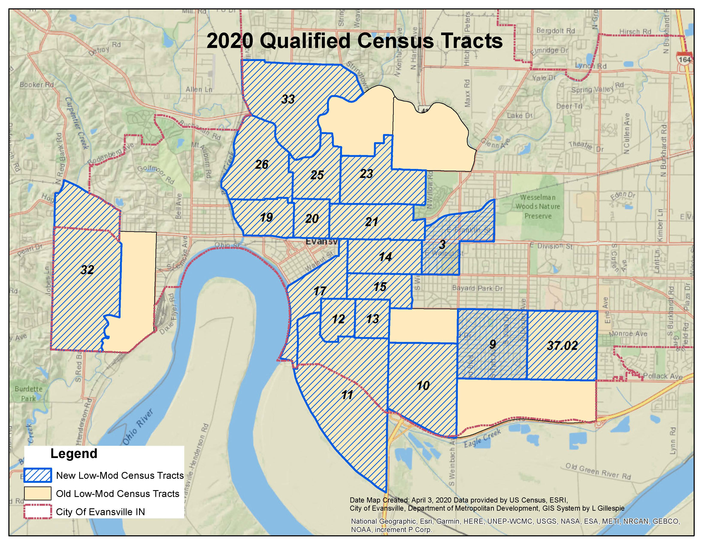
LOW-MOD CENSUS TRACTS

Slide 11
CDBG REVIEW CONTINUED
National Objectives continued
b) Limited Clientele (LMC) 51% LMI
Presumed Benefit (LMC/PB)-Must serve certain clientele exclusively:
Abused children
Elderly (62 years or older)
Battered spouses
Severely disabled adults
Illiterate adults
Persons living with HIV/AIDS
Migrant farm workers
Homeless persons

Slide 12
CDBG REVIEW CONTINUED
National Objectives continued
c) Housing Benefit (LMH)
Single Family – 100% LMI
Multi-Family – 51% LMI
d) Job Creation/Retention (LMJ)
Where 51% of jobs are taken by or made available to LMI persons

Slide 13
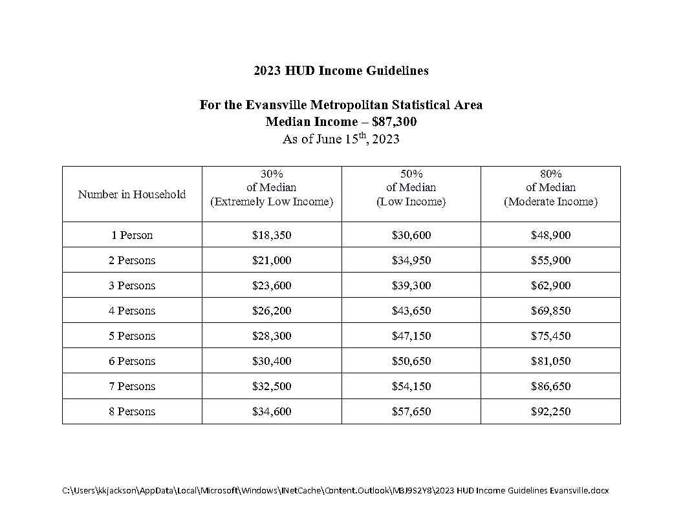
2023 income guidelines

Slide 14
CDBG ELIGIBLE ACTIVITIES
Acquisition of Real Property
Clearance
Code Enforcement
Construction of Housing
Disposition
Homeownership Assistance
Interim Assistance
Loss of Rental Income
Microenterprise Assistance
Miscellaneous Other Activities
Planning and Capacity Building
Privately-Owned Utilities
Program Administration Costs
Public Facilities and Improvements
Public Services
Rehabilitation
Relocation
Special Activities by CBDOs
Special Economic Development Activities

Slide 15
CDBG INELIGIBLE ACTIVITIES
The following activities may not be assisted with CDBG funds under any circumstance:
Buildings or portions thereof, used for the general conduct of government
General government expenses
Political activities

Slide 16
CDBG INELIGIBLE ACTIVITIES CONTINUED
The following activities may not be assisted with CDBG funds unless
authorized as Special Economic Development Activities under §570.203 or when carried out by a Community Based Development Organization (CBDO) under the provisions of §570.204.
Purchase of equipment
Construction equipment
Fire protection equipment
Furnishings and personal property
Operating and maintenance expenses
New housing construction
Income payments

Slide 17
SUMMARY OF CDBG ACTIVITIES
Eligible activities are so broad that it is easy to forget that some things cannot be done under the program.
Some activities will require an Eligibility Review by CD Staff to provide guidance in determining the eligibility of activities frequently associated with housing and community development.

Slide 18
HUD Allocations CDBG and ESG
Timeline (ONGOING)
ESG Overview
Proposals
CDBG Overview
Financial Responsibility
Monthly Monitoring Reports

Slide 19
Emergency Solutions Grant (ESG)
In Evansville there are about 500 individuals in shelter or transitional housing on any given night
50-60 homeless individuals on the street or places not meant for habitation
More than 2000 homeless served annually
Shelters stay at maximum capacity all year
HUD’s goal is to lessen the length of stay in shelter and move to permanent housing faster
Coordinated Entry Assessment prioritizes the homeless
Funds are meant to coordinate with other homeless funds such as CoC funds

Slide 20
ESG CONTINUED
4 Categories of Homelessness based on CoC and ESG:
Category 1: Literally Homeless.
Category 2: Imminent Risk of Homelessness.
Category 3: Homeless Under Other Federal Statutes.
Category 4: Fleeing/Attempting to Flee Domestic Violence.

Slide 21
ESG REGION 12 GOALS
The Region 12 Charter adopted on 12/14/2012 included 11 goals
These 11 goals have been consolidated to the following:
Support the availability of public services
Support rapid re-housing
Support the coordinated entry system
Support re-entry
Homeless goals support the overall annual goals of the City of Evansville

Slide 22
ESG CONTINUED
HEARTH Act stands for the Homeless Emergency and Rapid Transition to Housing Act of 2009.
Emergency Solutions Grant (ESG) is authorized by the HEARTH Act.
The current interim rule of the Emergency Solutions Grant took effect January 2012.
ESG has very strict requirements.
CDBG is a lot more flexible compared to ESG.

Slide 23
ESG CONTINUED
Emergency Solutions Grant (ESG) program completely replaced the Emergency Shelter Grant program of the late 70s
The current ESG is roughly equivalent to 60% of the old ESG

Slide 24
ESG Eligible Activities
Component | Serving:
 | Those who are Homeless | Those who are at risk of Homelessness
1. Street Outreach | √
2. Emergency Shelter | √
3. Homelessness Prevention* |  | √
4. Rapid Housing | √
5. Administration | √ | √
Data Collection:
6. Homeless Management Information System (HMIS) (provided by IHCDA) | √ | √
Details and instructions are located at 24 CFR 576 – Subpart B –
Program Components and Eligible Activities (24 CFR 576.100 – 109)
* Default to Rapid Re-Housing

Slide 25
ESG CONTINUED
Street Outreach
Eligible Program Participants:
Unsheltered homeless people who are unwilling or unable to access emergency shelter, housing, or an appropriate health facility, meaning those who qualify under paragraph (1)(i) of the definition of “homeless”, which includes individuals and families with a primary nighttime residence that is a public or private place not designed for or ordinarily used as a regular sleeping accommodation for human beings, including a car, park, abandoned building, bus or train station, airport or campground.
Overview of Eligible Activities:
Essential services* to eligible participants provided on the street or in parks, abandoned buildings, bus stations, campgrounds, and in other such settings where unsheltered persons are staying. Staff salaries related to carrying out street outreach activities are also eligible. * Essential services must be included under the street outreach component in the interim rule to be eligible with ESG funds.

Slide 26
ESG CONTINUED
Emergency Shelter
Eligible Program Participants:
Individuals and families who are homeless (Categories 1-4 of the Homeless definition).
Eligible Activities:
Essential services to persons in emergency shelters*, renovating buildings to be used as emergency shelters, and operating emergency shelters. Staff costs related to carrying out emergency shelter activities are also eligible.
Costs to operate and maintain emergency shelters and also provide other emergency lodging when appropriate.
ESG funds may be used for day shelter if:
Meets the definition of a shelter §576.2

Slide 27
ESG CONTINUED
Rapid Re-housing
Homeless Definition:
Categories 1-4 of the Homeless definition. Individuals and families must have an income at or below 30% AMI at annual re-evaluation.
Overview of Eligible Activities:
Short and medium term rental assistance and housing relocation and stabilization services. Staff salaries related to carrying out rapid re-housing.

Slide 28
ESG CONTINUED
The City estimates $200,000 of ESG funds based on prior year allocations.
Rapid Re-Housing must be funded per HUD rules.
For ESG, funds start out in Rapid Re-Housing as the default.
All ESG can be allocated to Rapid Re-Housing or allocate less than $129,964 to Homeless Assistance (Street Outreach, Emergency Shelter)
More than $70,036 must remain in Rapid Re-Housing.

Slide 29
Record Retention
Recipients of federal funds are responsible for proper recordkeeping and retention. Records should be sufficient to establish an audit trail for all transactions involving federal funds. An audit trail for federal funds originates with the preparation of the grant proposal or contract proposal, and includes adequate records to support statements in the proposal document.
ESG records must be kept 5 years after the conclusion (Close-out) of the program: effectively 6 years.

Slide 30
Match Requirements
Each ESG sub-recipient, must match funding provided with an equal amount of funds from other sources.
Matching funds must be related to expenditures occurring
after the date of grant award.
Funds used to match a previous ESG grant may not be used to match a subsequent grant award.

Slide 31
Match Requirements (Continued)
In general, matching funds provided may consist of:
Amount of funds from other sources;
Salary paid to staff (not included in the award) to carry out the project of Grantee;
The value of any donated material or building, or of any lease, calculated using a reasonable method to establish a fair market value;
Time contributed by volunteers; and
Matching funds or voluntary efforts provided by any recipient or project sponsor.
24 CFR 576.201 contains match requirements

Slide 32
HUD Allocations CDBG and ESG
Timeline (ONGOING)
ESG Overview
Proposals
CDBG Overview
Financial Responsibility
Monthly Monitoring Reports

Slide 33
PROPOSALS
The 2024 CDBG and ESG proposal packets will be available on the City of Evansville, Community Development website by July 3, 2023 at the link below:
www.evansville.in.gov/cdfederalprograms

Slide 34
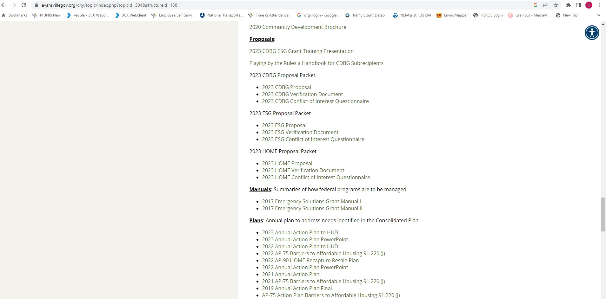

Slide 35
Summary of proposal:
Both the CDBG and ESG Proposals are divided into (4)sections.
General Information
Project information
Financial
Affiliations and Board of Directors Information

Slide 36
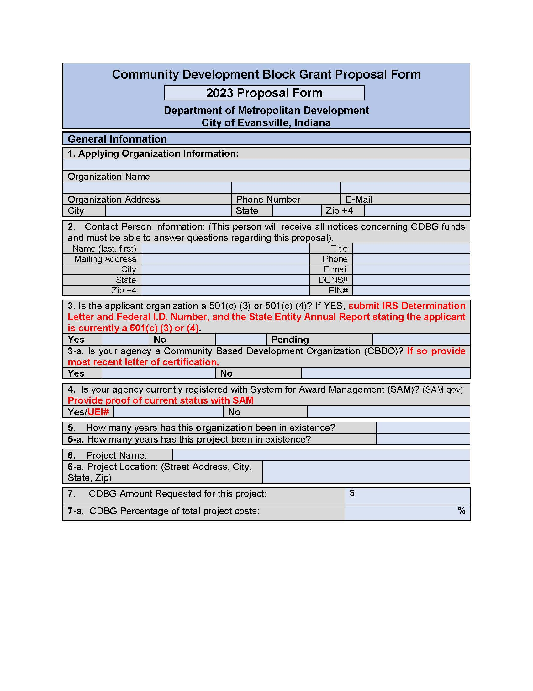
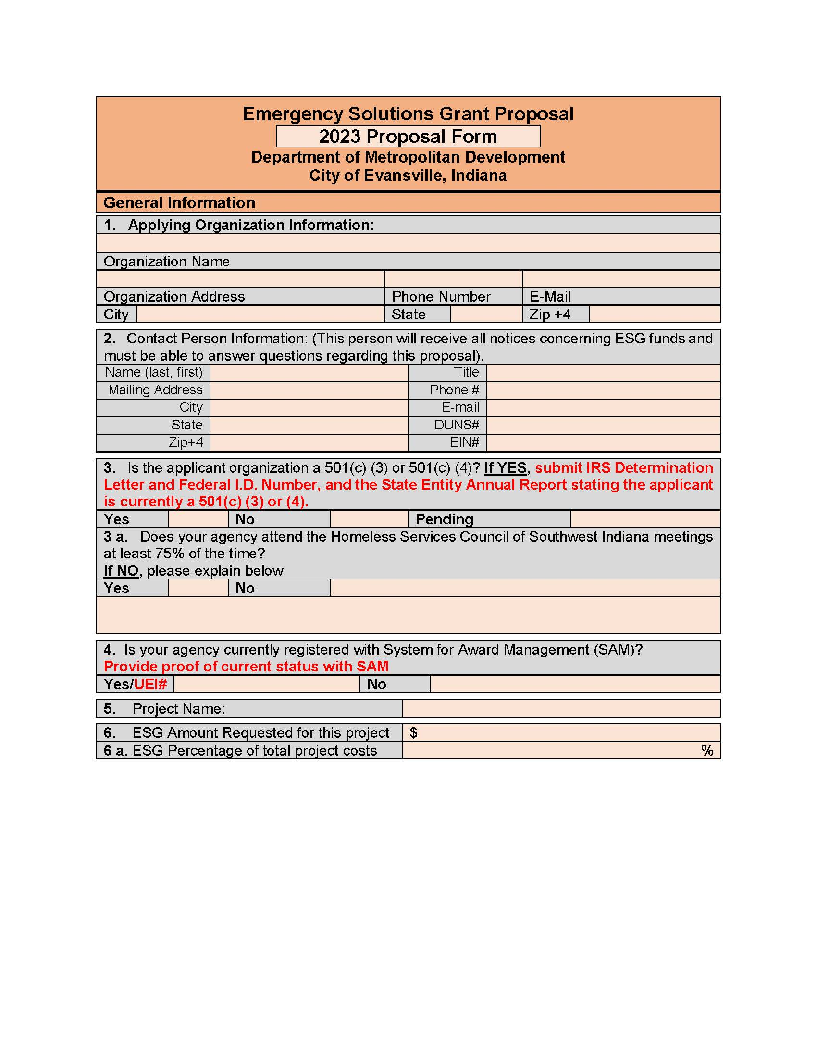
PROPOSALS

Slide 37
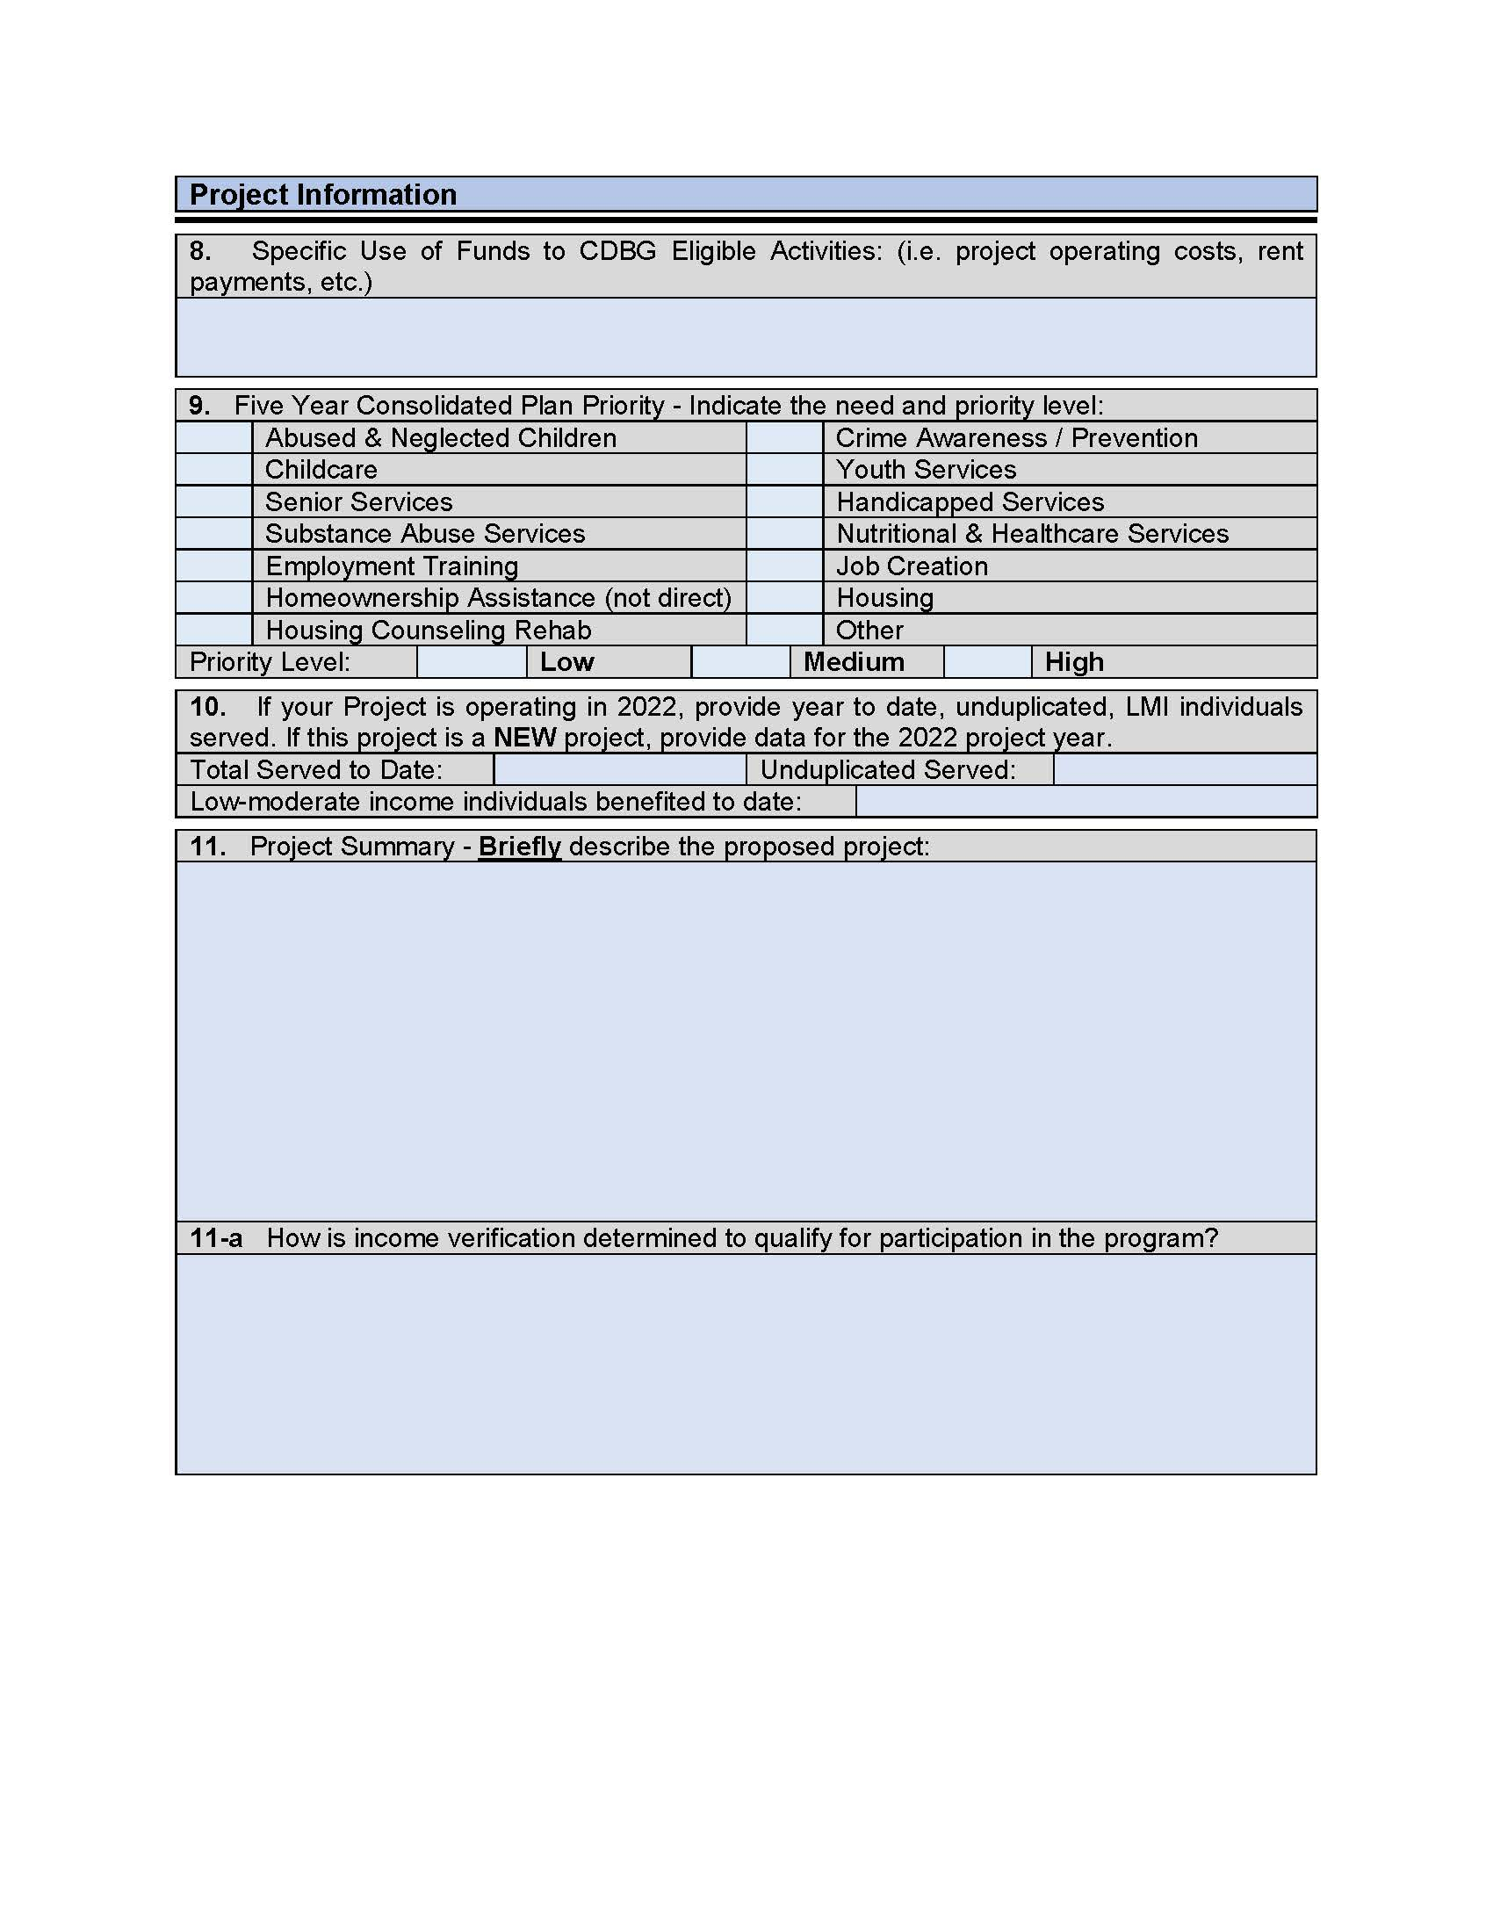
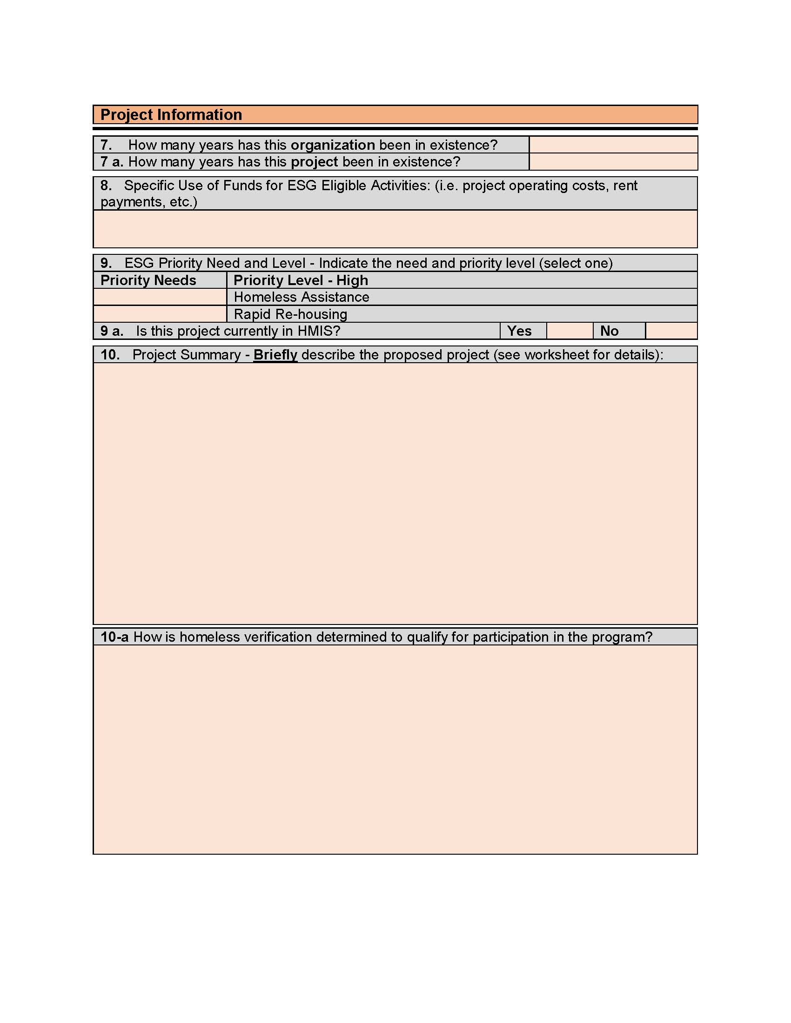
PROPOSALS

Slide 38
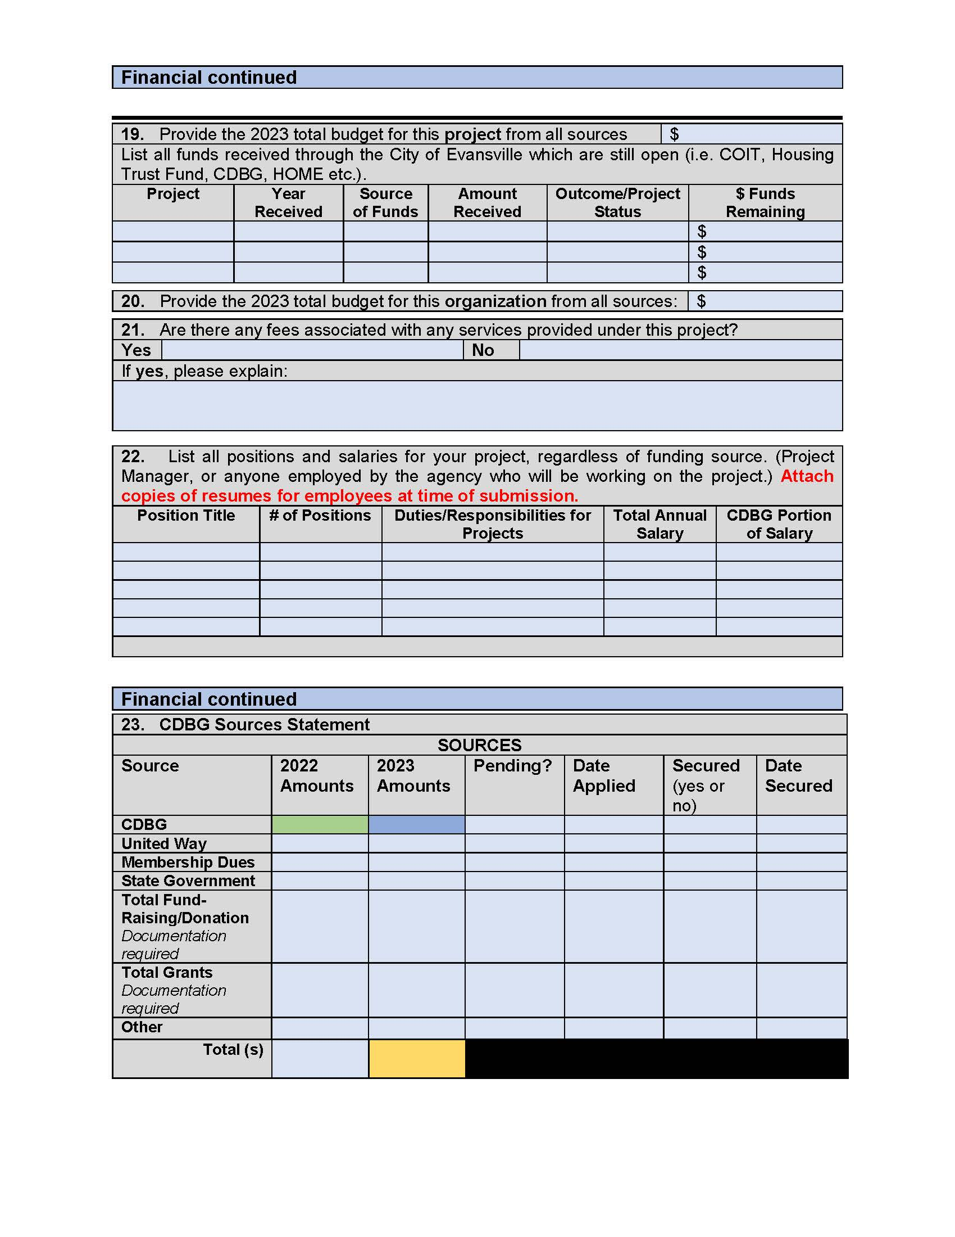
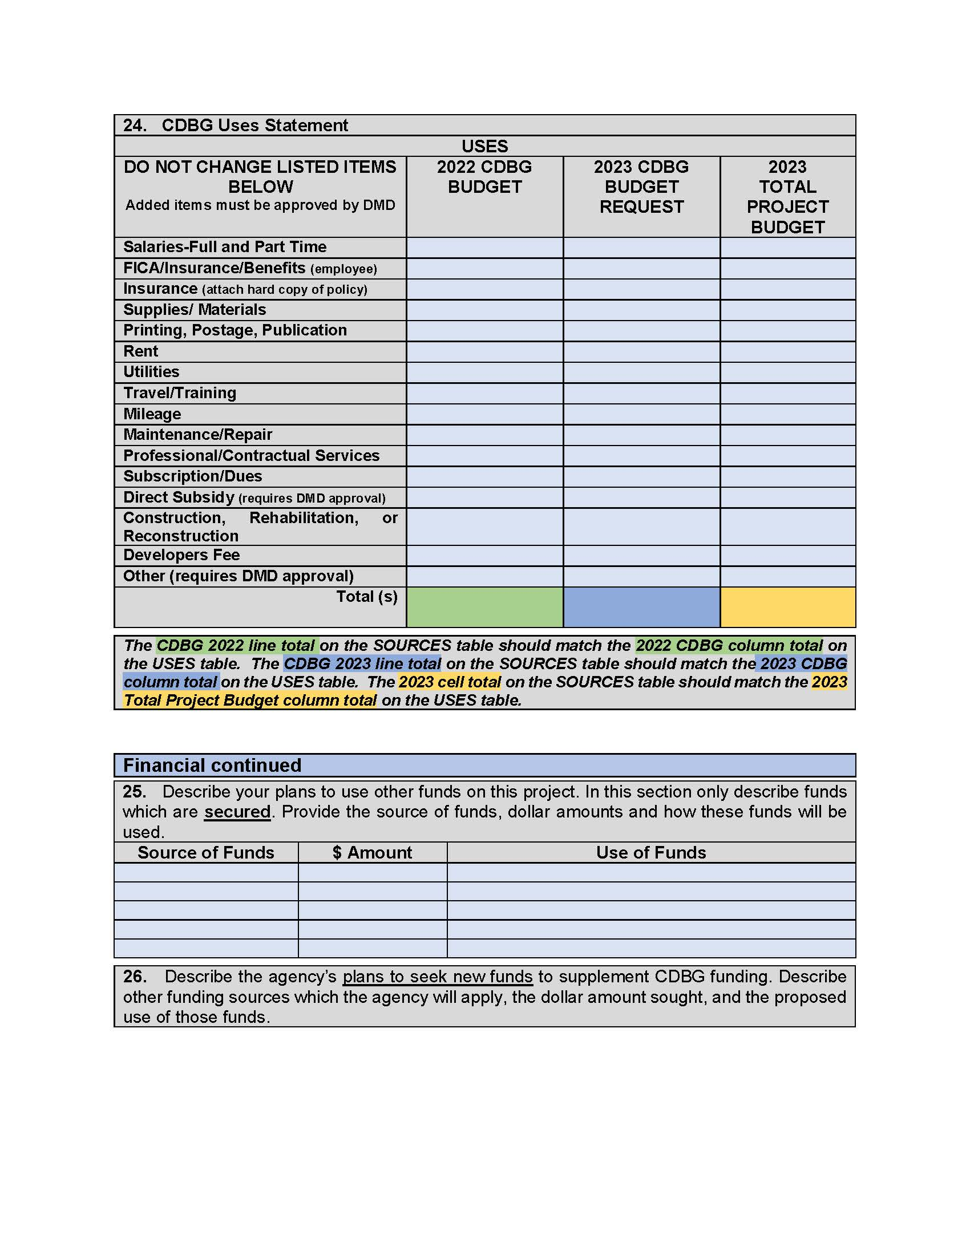
PROPOSALS

Slide 39
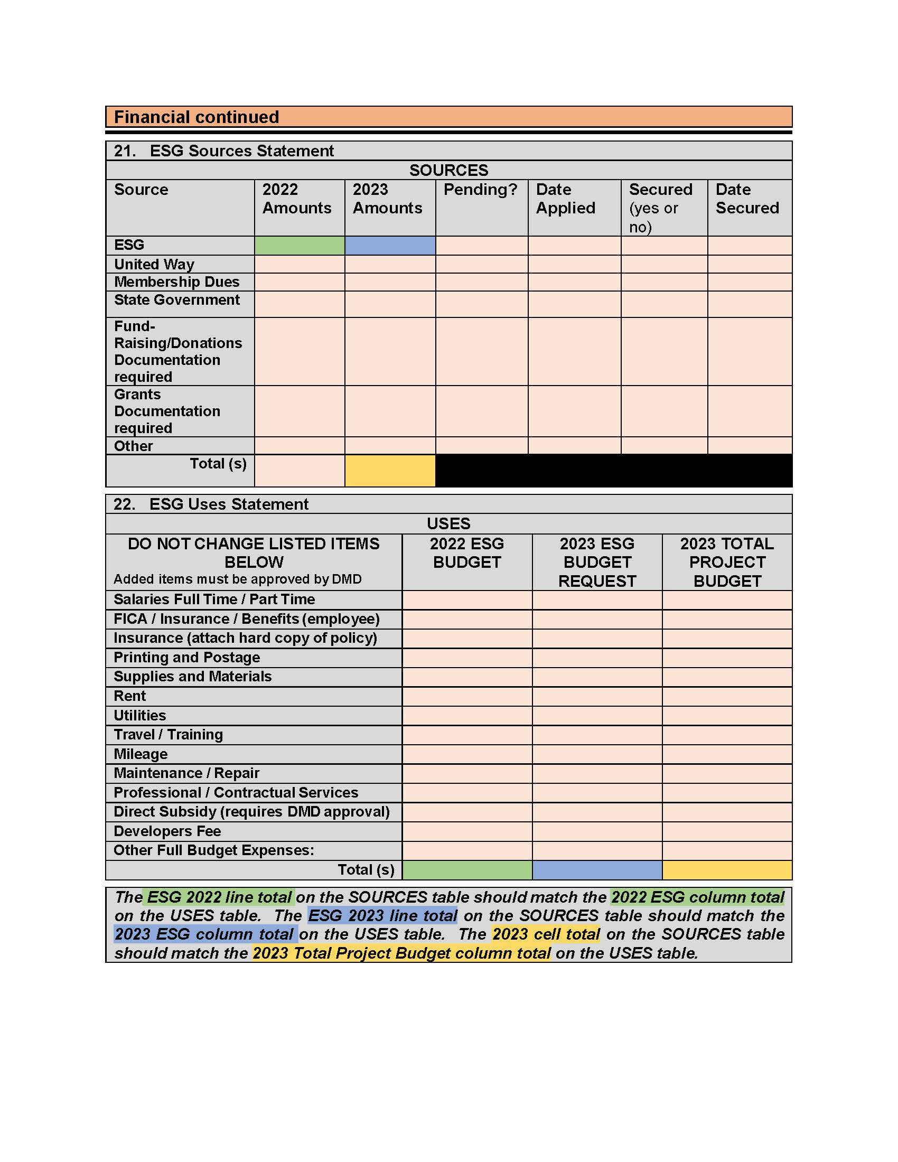
PROPOSALS

Slide 40
Proposals
There are several additional documents included with grant proposals
Verification Page – Original signature required
Conflict of Interest Questionnaire – complete one for each program submitted
ALL DOCUMENTS LISTED ABOVE WILL BE AVAILABLE ON THE CITY WEBSITE AS OF JULY 3, 2023

Slide 41
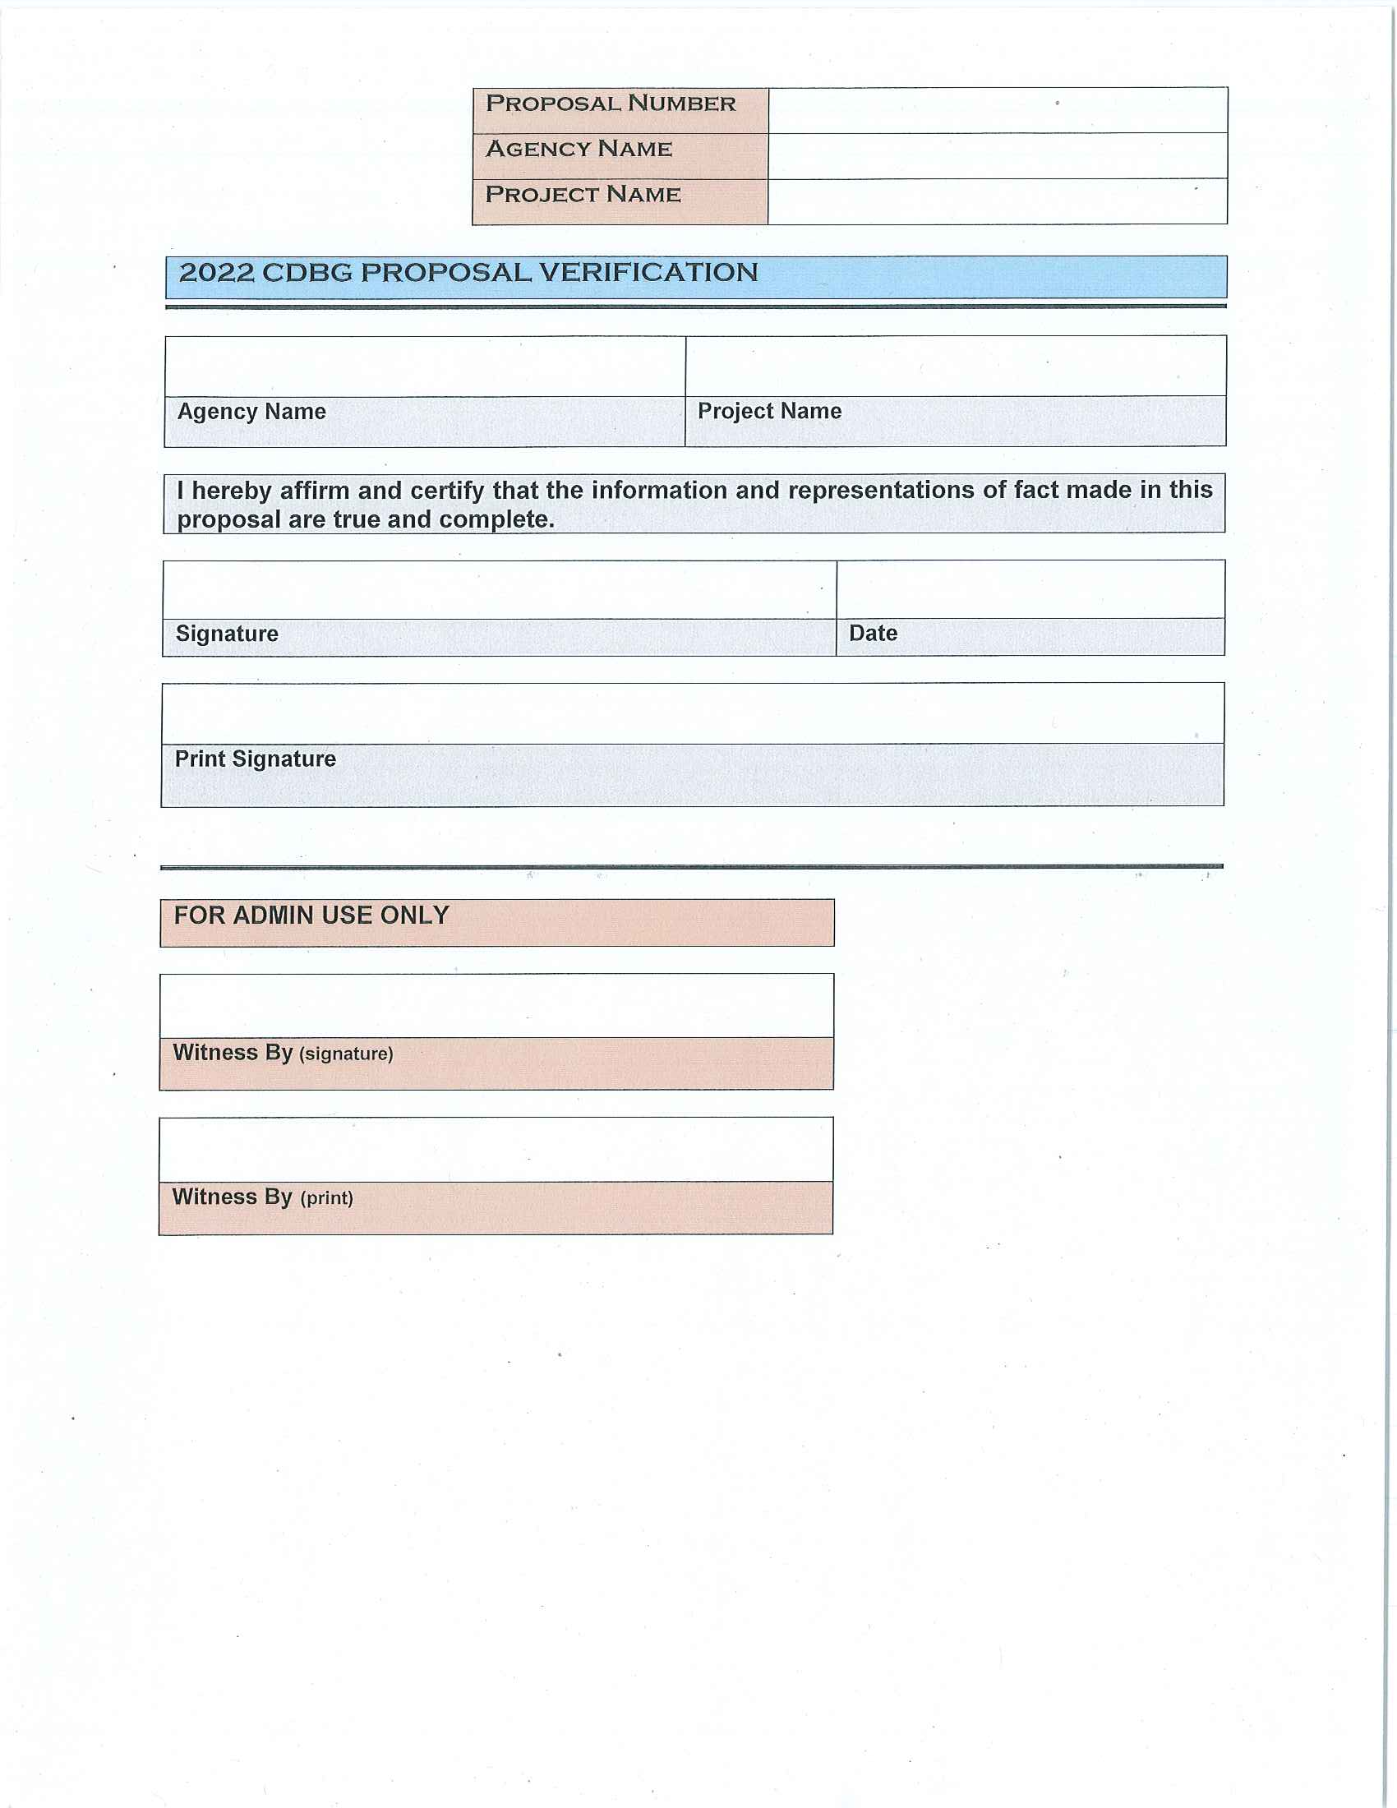
PROPOSALS

Slide 42
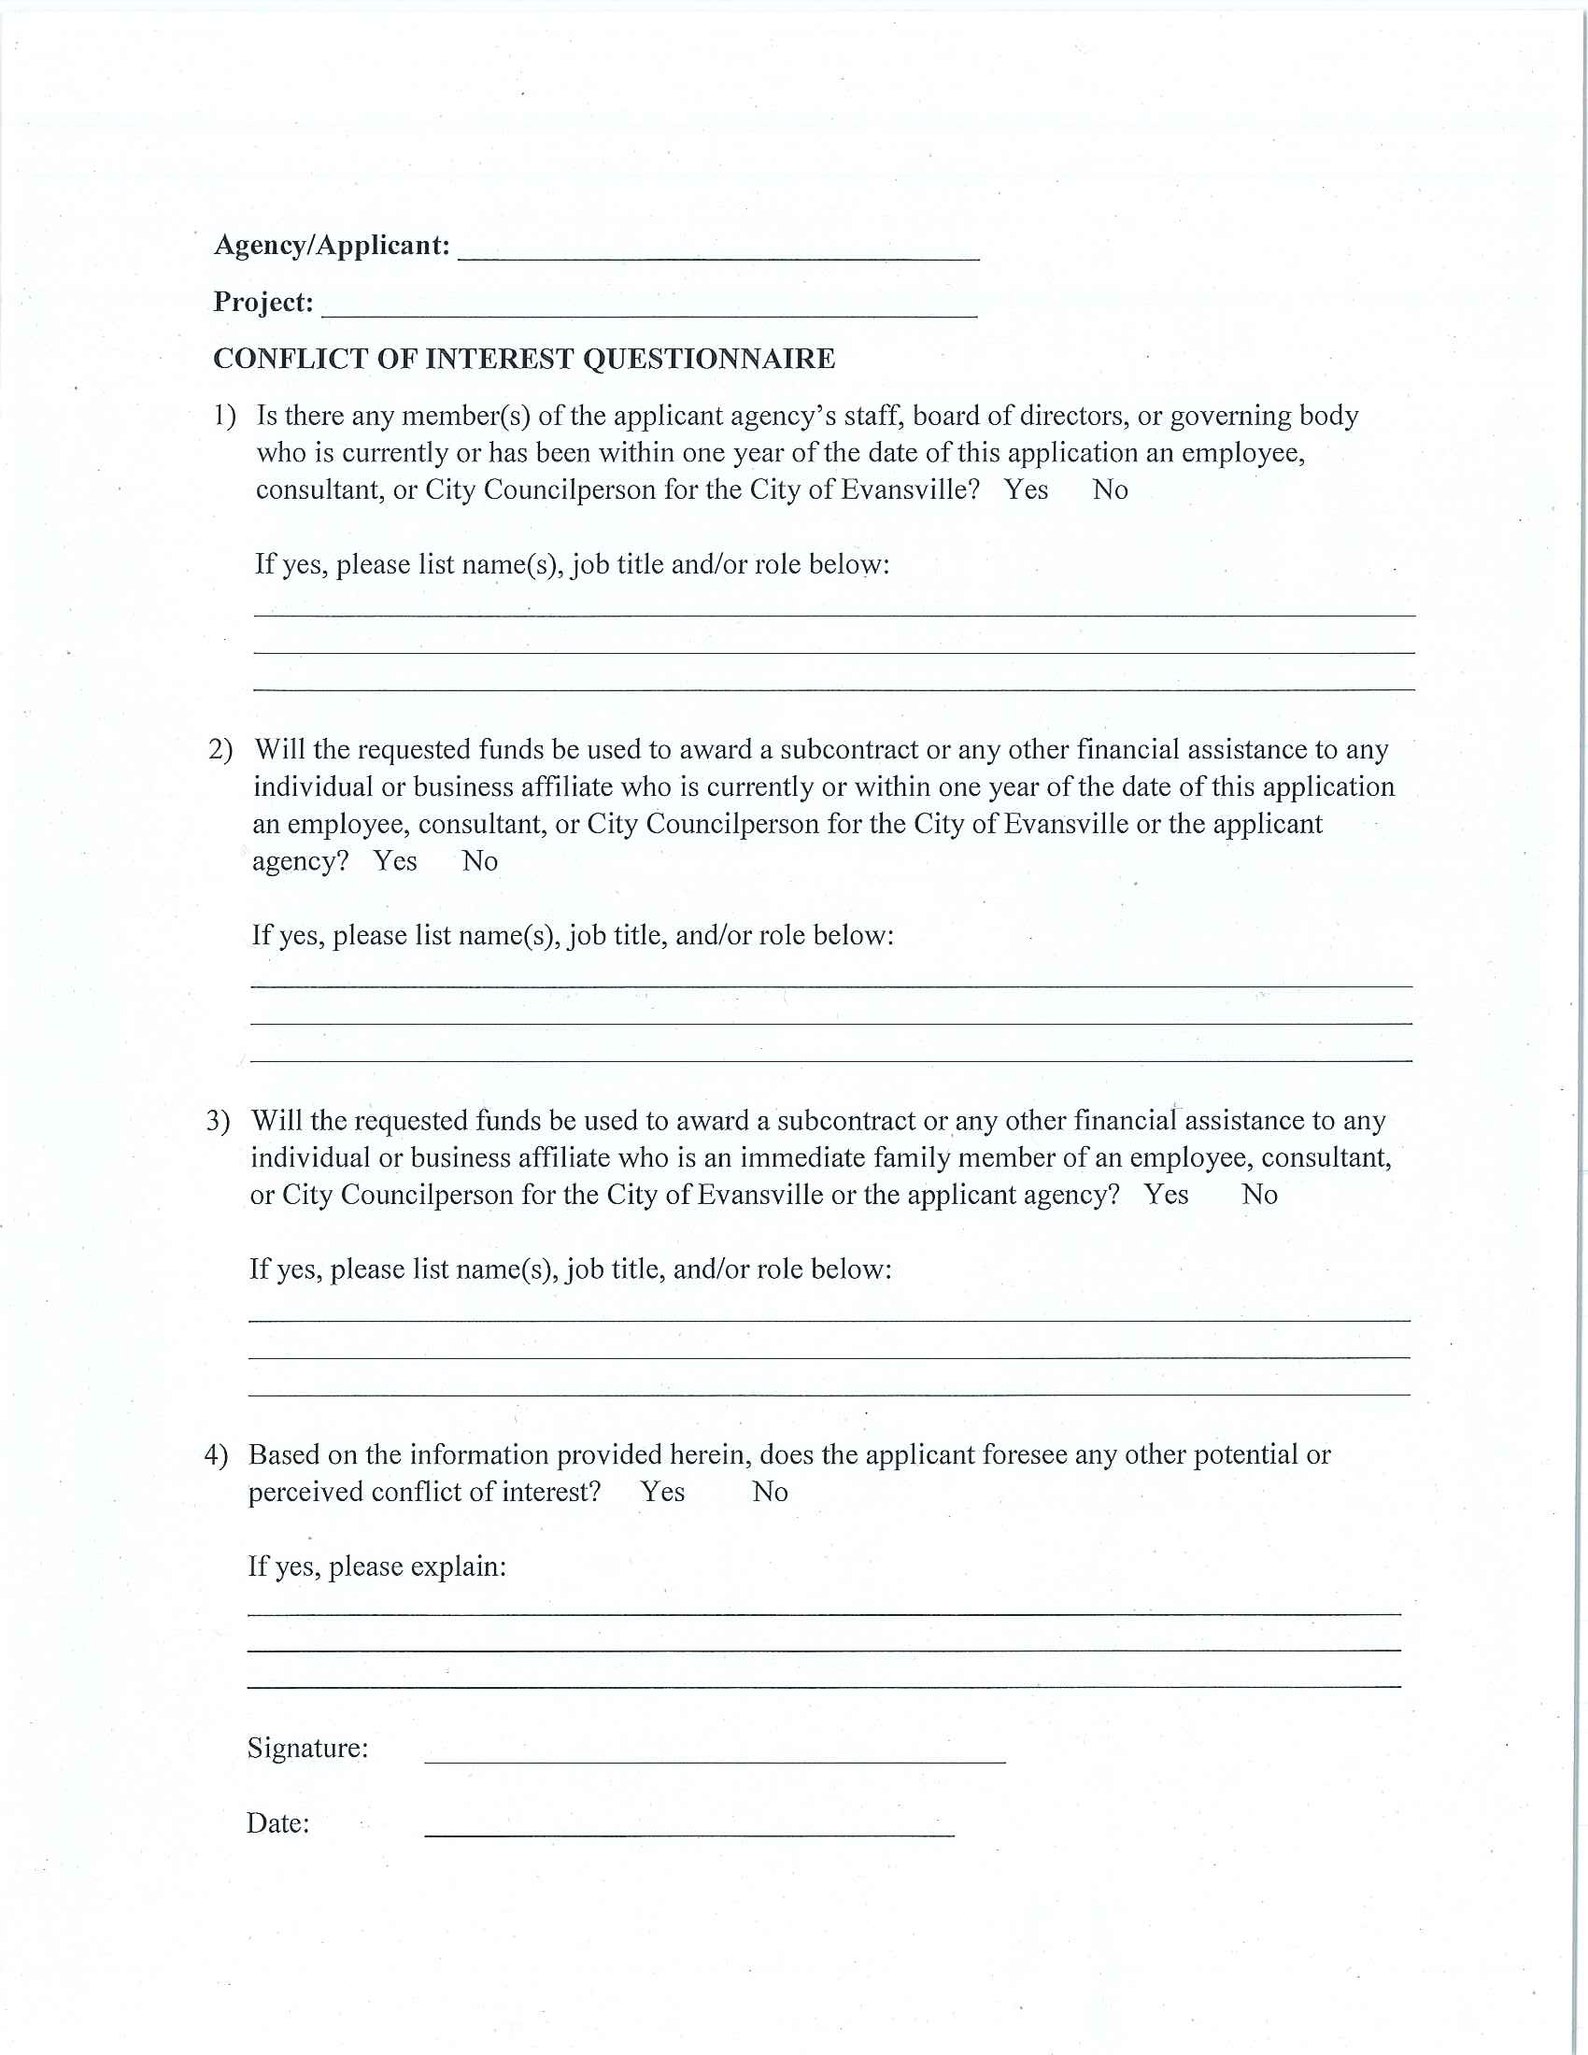
PROPOSALS

Slide 43
Summary of REQUIRED ATTACHMENTS
Current 501 C (3) or 501 C (4) Documents
CBDO Certification letter (if applicable)
Most recent Audit report
Resumes, etc….
Current MOU’s (if applicable)
Complete List of Board Members
Policy and Procedures for Board Member participation
Conflict of Interest Statement

Slide 44
Proposal submittal process
Attendance at proposal training session is mandatory
Proposals available on City website by July 3rd
www.evansville.in.gov/cdfederalprograms
Complete proposal and schedule review appointment with assigned CD Specialist
After review appointment with CD Specialist, make edits as needed and submit Word format ONLY copy of proposal via email to Specialist. Include all supporting documentation as required with final proposal.
Deliver final, signed copy of proposal with $20.00 fee (checks required, no cash or personal checks) for each proposal submitted to DMD, Room 306 Civic Center Complex by 4:00 pm on August 2nd .
Checks to be made out to the Department of Metropolitan Development (include description in memo line)
Application fee is NOT reimbursable

Slide 45
PROPOSAL TIMELINE
Agency Mandatory Appointment with CD staff for Proposal review: July 3rd to July 28th
2024 Approved Proposals due: August 2nd
JULY 2023
AUGUST 2023
Sun | M | T | W | TH | F | Sat
 |  |  |  |  |  | 1
2 | 3 | 4 | 5 | 6 | 7 | 8
9 | 10 | 11 | 12 | 13 | 14 | 15
16 | 17 | 18 | 19 | 20 | 21 | 22
23 | 24 | 25 | 26 | 27 | 28 | 29
30 | 31
Sun | M | T | W | TH | F | Sat
 |  | 1 | 2 | 3 | 4 | 5
6 | 7 | 8 | 9 | 10 | 11 | 12
13 | 14 | 15 | 16 | 17 | 18 | 19
20 | 21 | 22 | 23 | 24 | 25 | 26
27 | 28 | 29 | 30 | 31

Slide 46
Agency Packets
Welcome Letter
Playing by the Rules Handbook for CDBG Subrecipients
SAM Information
Vendor Registration Information
Claim Reimbursement Information

Slide 47
HUD Allocations CDBG and ESG
Timeline (ONGOING)
ESG Overview
Proposals
CDBG Overview
Financial Responsibility
Monthly Monitoring Reports

Slide 48
Financial Responsibility
Introduction
Overview
Vendor Self-Service
SAM Registration
Claims Process
Example of Claim Packet
Common issues with Claim Submissions
Monthly Monitoring Reports
Timeliness
Reconciliation Responsibilities
Audits
Wrap-up
Notes:
Lesson descriptions should be brief.

Slide 49
INTRODUCTION
Lisa C. Smith, Finance Officer
Department of Metropolitan Development
812-436-7807
lismith@evansville.in.gov

Slide 50
overview
The City of Evansville (COE), the Department of Metropolitan Development (DMD)….
…follow Indiana State Board of Accounts guidelines for accounts payable processing.
…its agencies and subrecipients, must comply with the Office of Management and Budget Guidance (Code of Federal Regulations) 2 CFR Part 200, the ”Uniform Administrative Requirements, Cost Principals, and Audit Requirements for Federal Awards.”
…and HUD expect that subrecipients will comply with all applicable Federal requirements, document your performance, and follow effective accounting and management practices.
Simply stated, Federal and State requirements specify how DMD can disburse these funds. DMD and all Subrecipients of these funds are required to follow these regulations.

Slide 51
Vendor self service
Every grant recipient must have an active Vendor Self Service Account with the City of Evansville
If you are already setup, please log in and make sure your account information is accurate
Vendor Self Service Set up
IRS Form W-9
Conflict of Interest Form
Required documents must be uploaded in Vendor Self Service

Slide 52
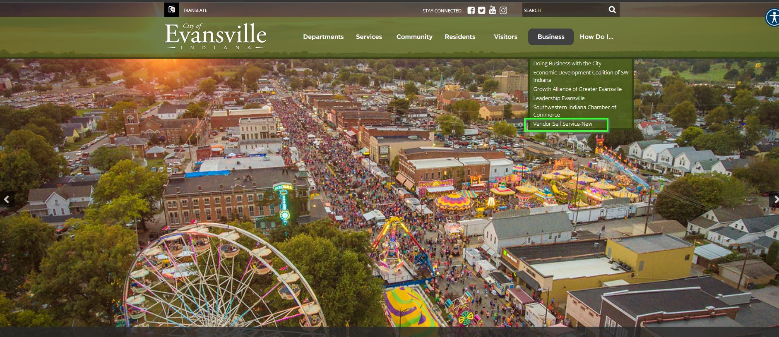

Slide 54
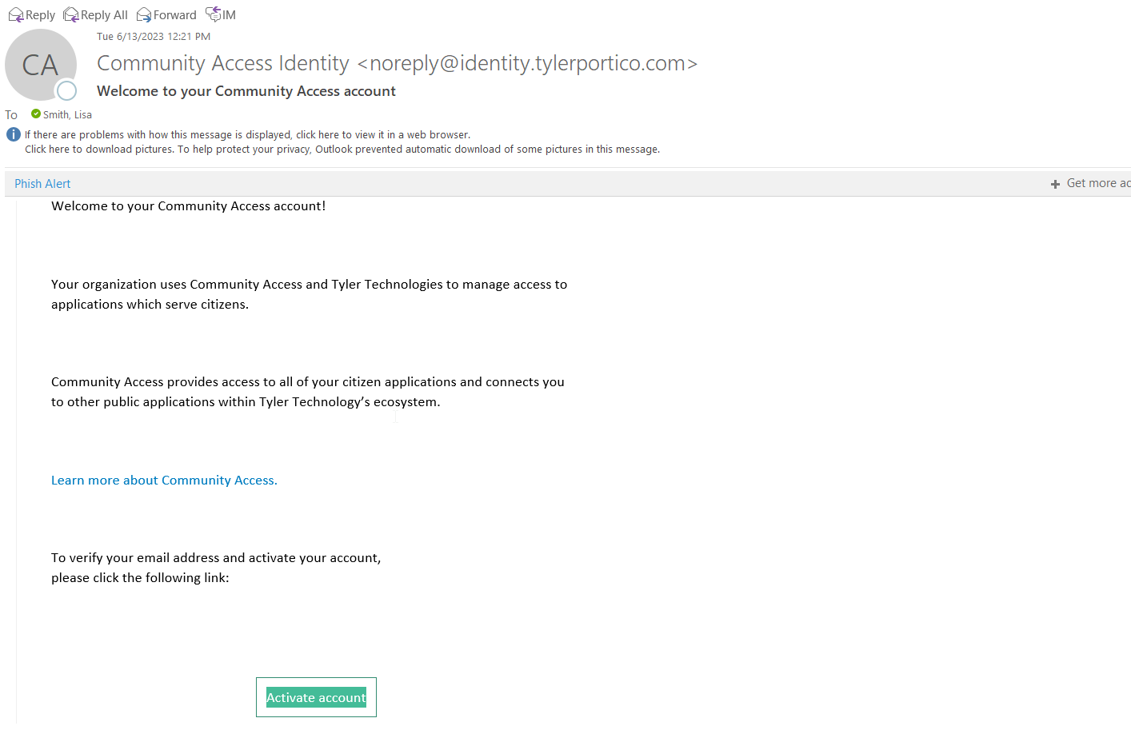
Email activation

Slide 55
Vendor Profile Editor

Slide 56
Vendor Self Service

Slide 57
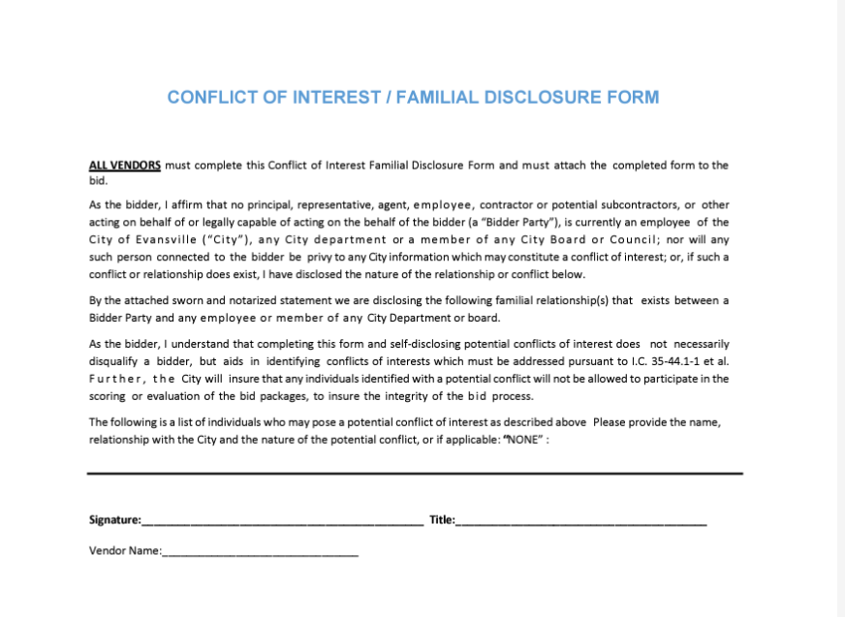
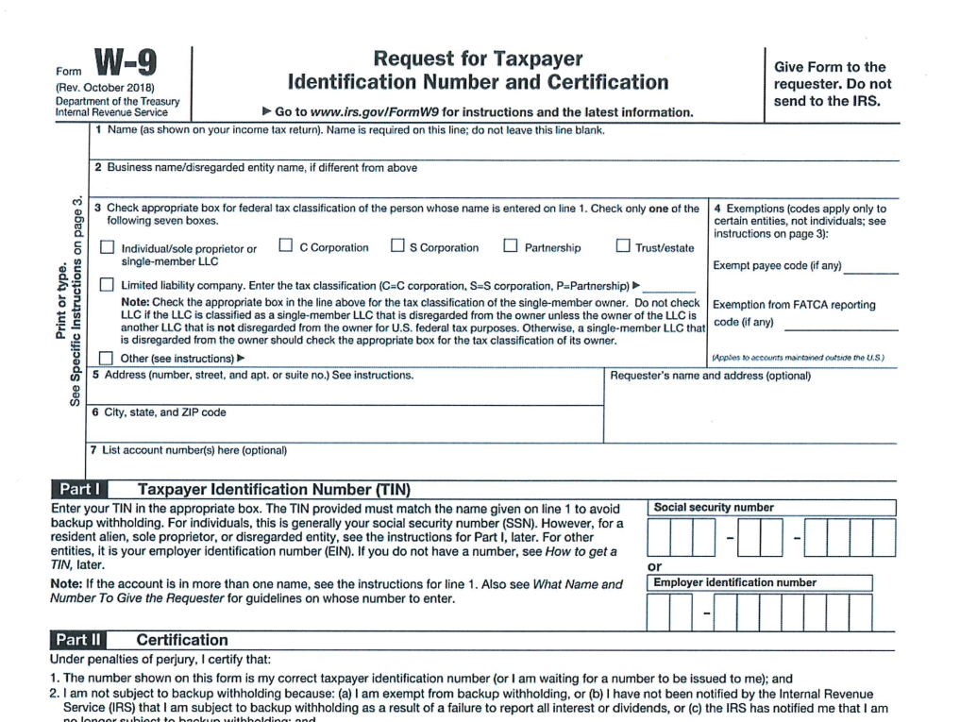

Slide 58
Vendor Attachments

Slide 59
SAM REGISTRATION
Per the Quick Start Guide for Contract Registrations pamphlet,“SAM.gov is an official website of the United States government. There is NO charge to register or maintain your entity registration record in SAM.gov.”
A SAM Registration is required for any contractor, organization or individual desiring to do business with the government. With this registration, you are allowed to bid on government contracts and apply for federal assistance.
Registration must be renewed yearly for it to remain active.

Slide 60
SAM REGISTRATION
Reimbursement will not be approved if SAM Registration is “INACTIVE”
Upon registration, you will be assigned a Unique Entity ID number (UEI). This UEI number is now used in place of the DUNS Number. This UEI number will now be required for all contracts with The City of Evansville.
When registering, make sure that you mark your information “for public display”; this public display will not include any private account information. If this option is not checked, we cannot verify your eligibility and it may not be visible to others looking for registered contractors.

Slide 61
CLAIMS PROCESS
As part of the proposal process, an agency must submit a budget for approval. Budgets MUST contain the anticipated amount and type of expense requested for reimbursement. Please be specific.
Once your budget is approved you will receive a Notice to Proceed, Purchase Order, and an Operating Agency Invoice Template. You may begin submitting claims for expenses incurred during the new contract period starting 7/1/2024 – 6/30/2025.
Unbudgeted expenses included in submitted claim will not be paid until a revised budget is submitted and approved by DMD.

Slide 62
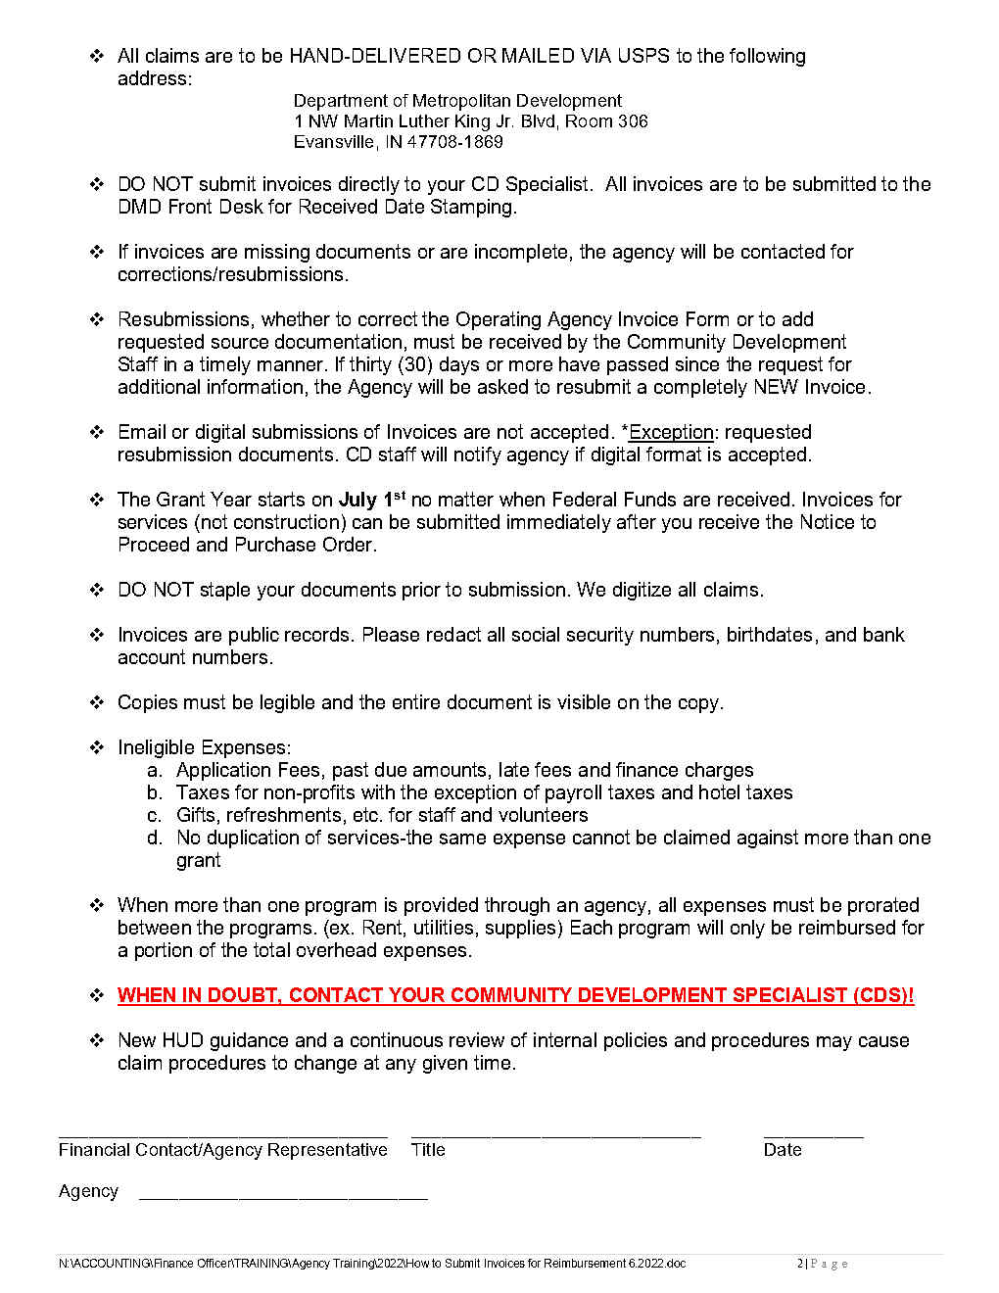
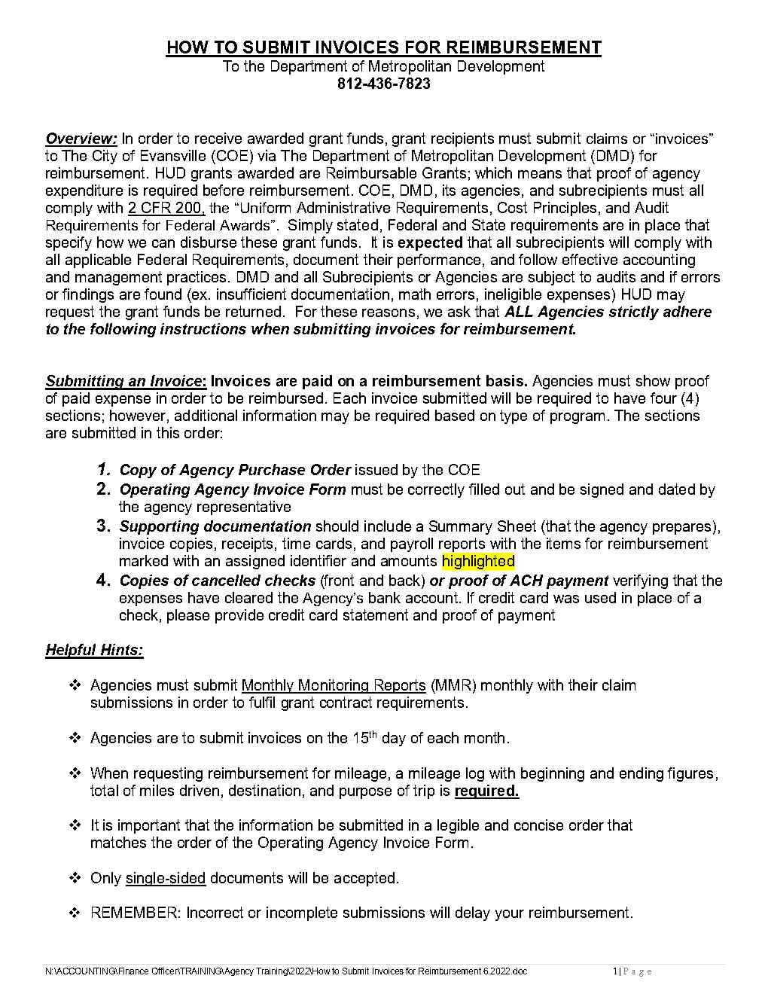
Claims Process-How To Submit Invoices For Reimbursement

Slide 63
Each claim submitted will have four (4) required components:
1. Copy of Purchase Order
2. Completed Operating Agency Invoice
3. Supporting Documentation
Summary Spreadsheets
Vendor Invoices
4. Proof of Funds Expended via cancelled check and/or bank statement
Redact any sensitive information-ex. Social Security Numbers, Date of Birth, Addresses of Employees, Bank Account Numbers
CLAIMS PROCESS

Slide 64
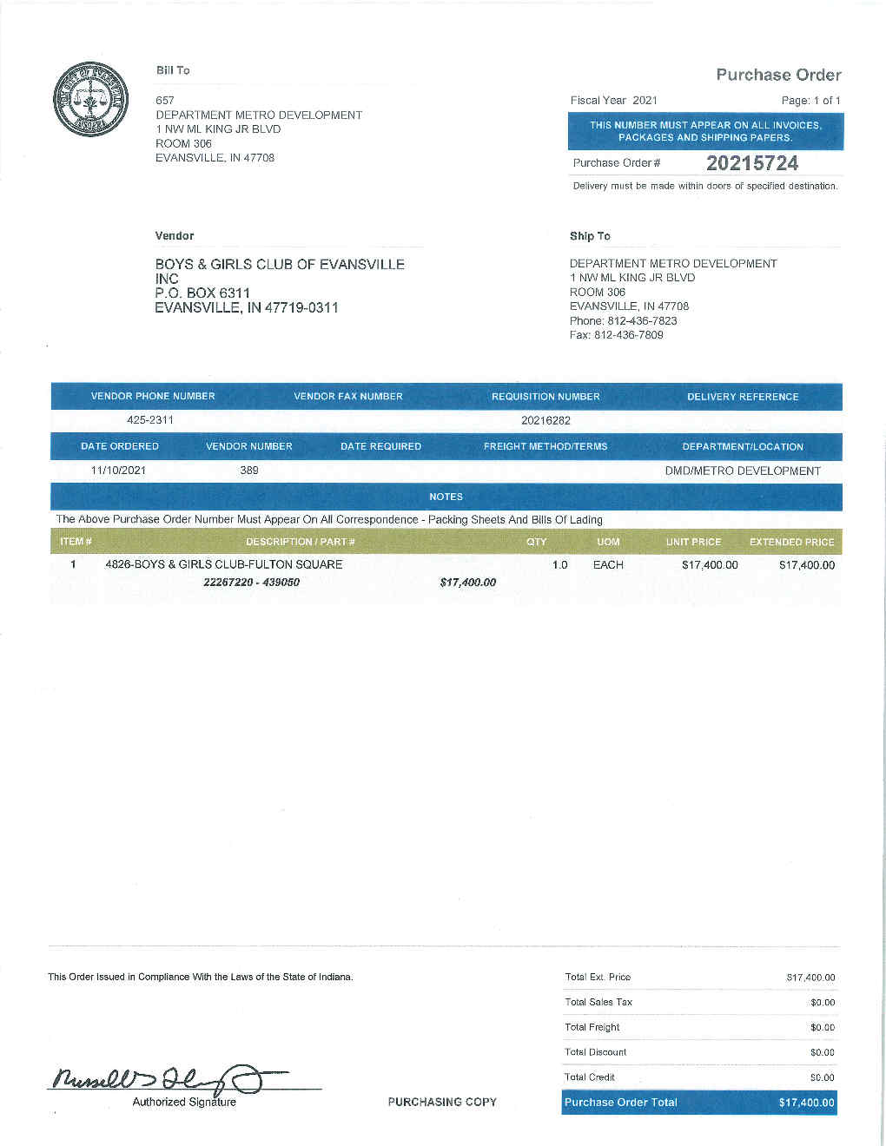
EXAMPLE OF CLAIM PACKET
Purchase Order

Slide 65
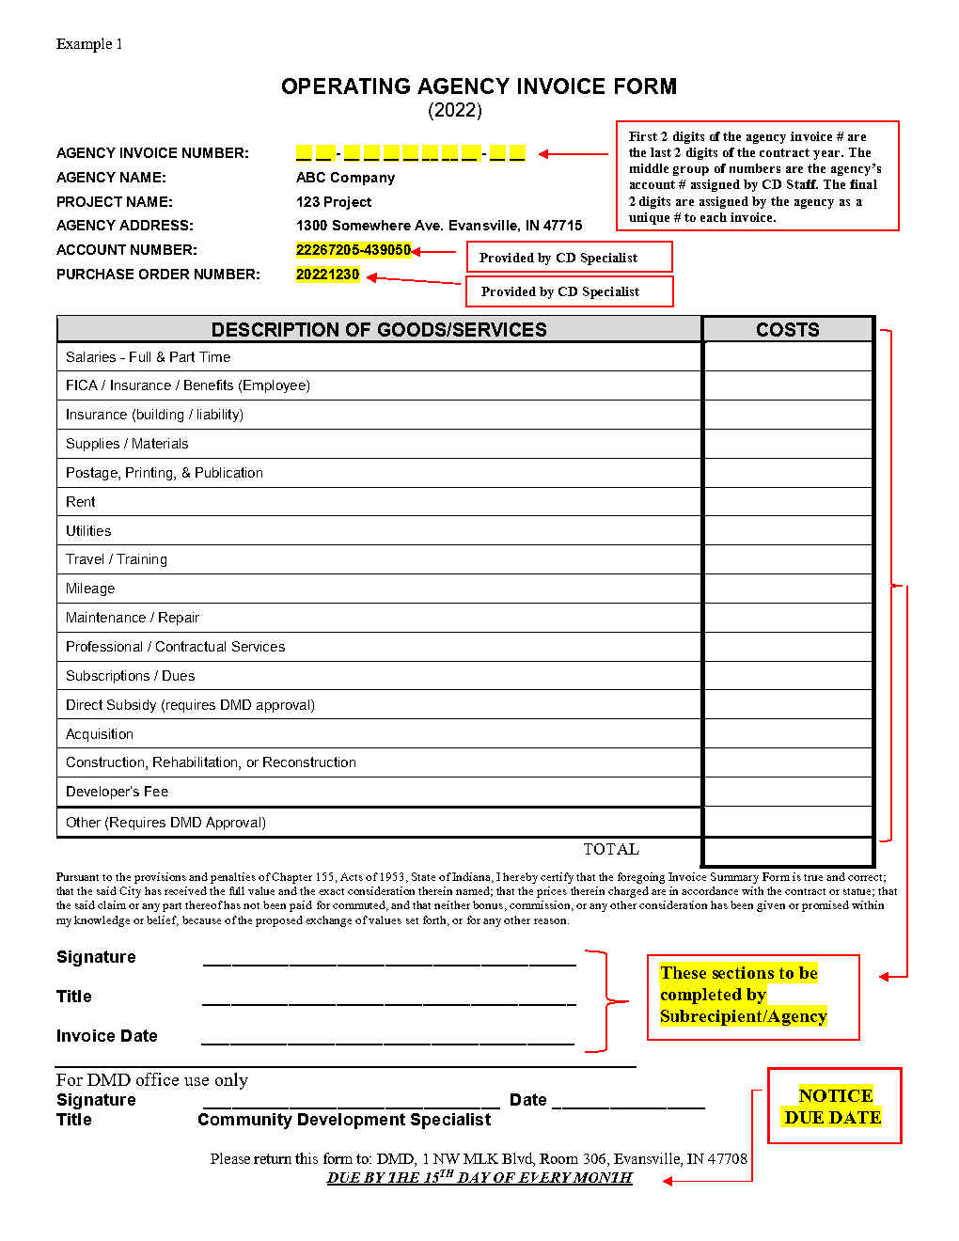
EXAMPLE OF CLAIM PACKET
Operating Agency Invoice Form

Slide 66
EXAMPLE OF CLAIM PACKET
Source Documentation SUMMARY SHEET
A Summary Sheet is a spreadsheet that the agency prepares with a breakdown of all expenses with check numbers. The summary sheet should include original invoice amounts and the amount being claimed. It must be organized in the same order as the line items on the Operating Agency Invoice Form.
Please assign an assigned identifier to each expense and record that number on the supporting docs including Vendor Invoice, and Check copies. (See Examples #1 & 2)
For salaries, show total hours worked for the pay period (including any non-program hours) and total program hours claimed with hourly wage for claimed hours per employee. (See Examples #1 & 2); also marked with the assigned identifier.

Slide 67
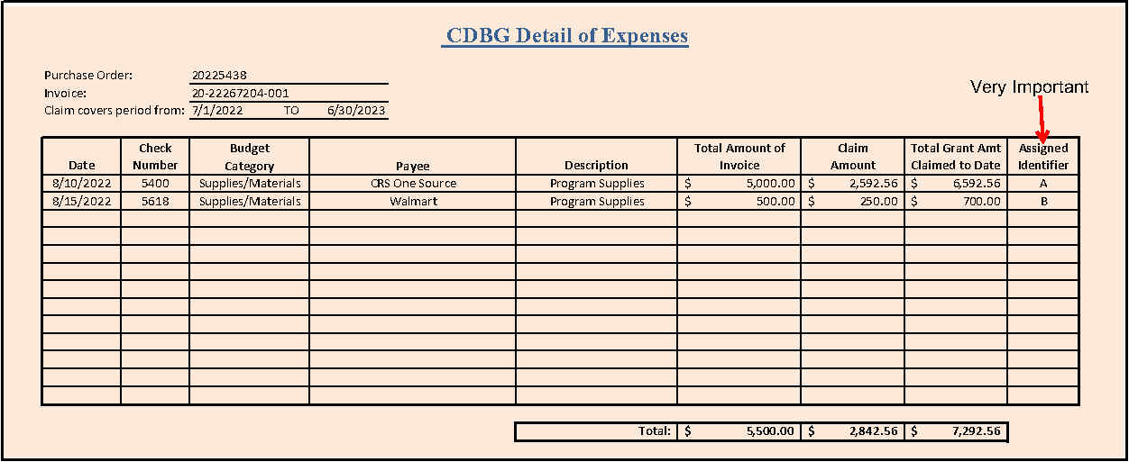
EXAMPLE OF CLAIM PACKET
SOURCE DOCUMENTATION Summary Spreadsheet-For Expenses

Slide 68
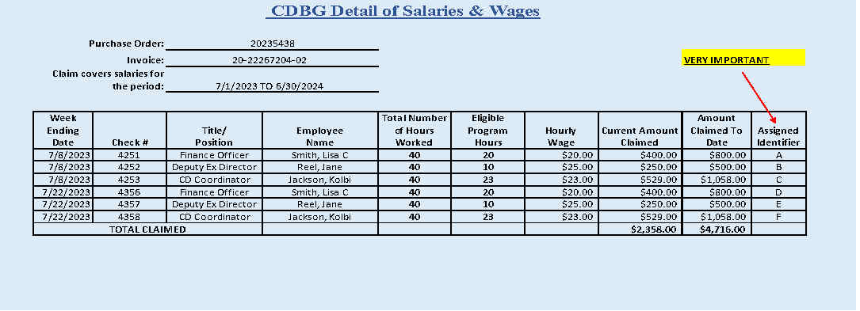
EXAMPLE OF CLAIM PACKET
SOURCE DOCUMENTATION Summary Spreadsheet-For Salaries

Slide 69
Source Documentation-Vendor Invoices
Expenses-Vendor Invoices & Receipts must include:
Date of invoice
Date of service
Total invoice amount
Amount claimed
Assigned Identifier-clearly marked

Slide 70
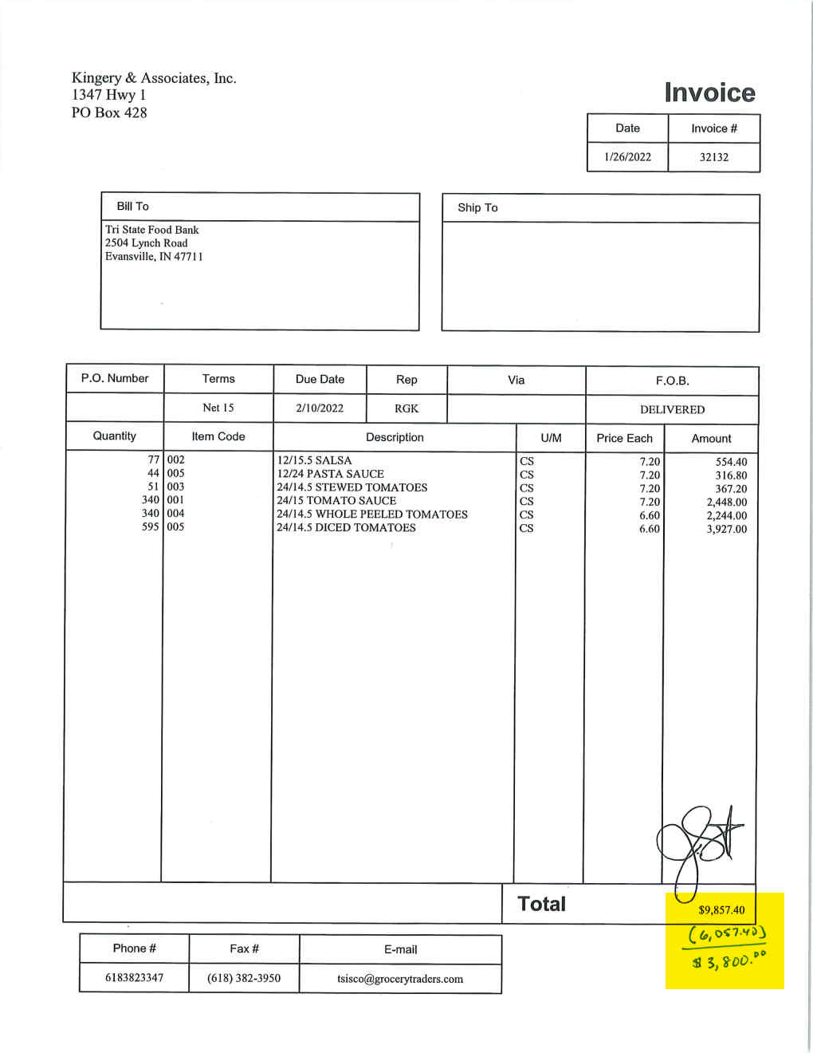
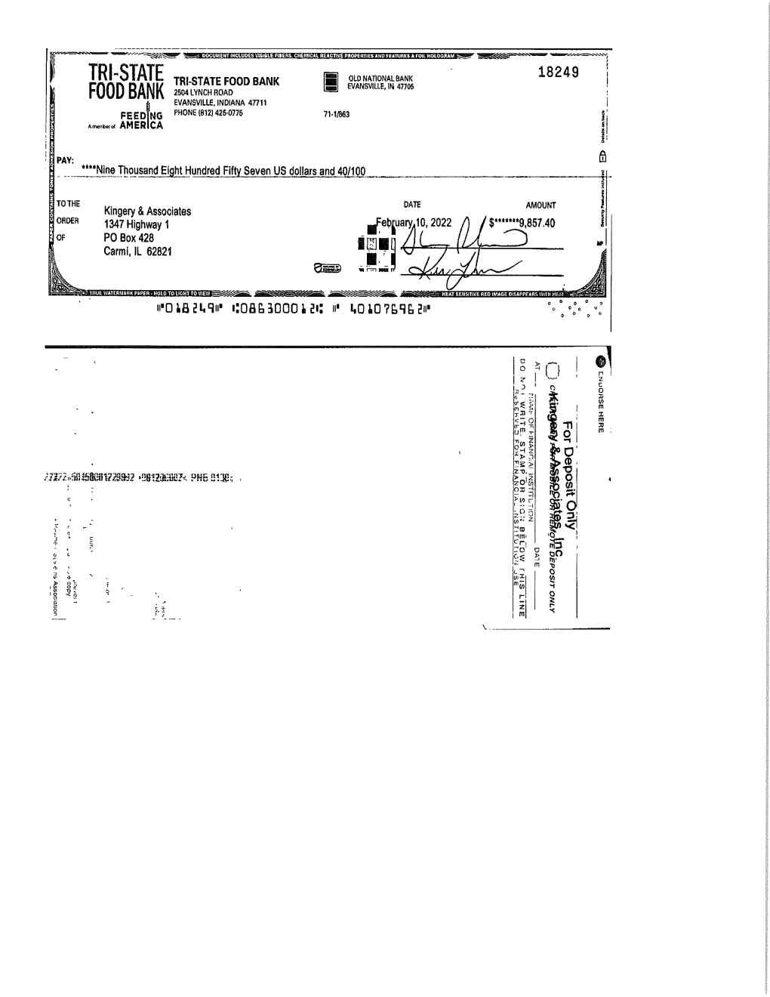
Claim Packet-Source Documentation
Example of actual vendor invoice with cancelled check
A
A

Slide 71
Source documentation-Payroll
TWO Payroll documents required
Time Cards – MUST
a. BE Signed by employee and supervisor (HUD requirement)
b. show total time worked
c. provide ADDITIONAL time tracking documentation for any employee that works on more than one program.
2. Payroll Journals and Reports- MUST INCLUDE
a. EMPLOYEE HOURLY AMOUNT
b. PAY PERIODS
c. PAY DATES
d. CHECK NUMBER OR ACH TRANSACTION NUMBER

Slide 72
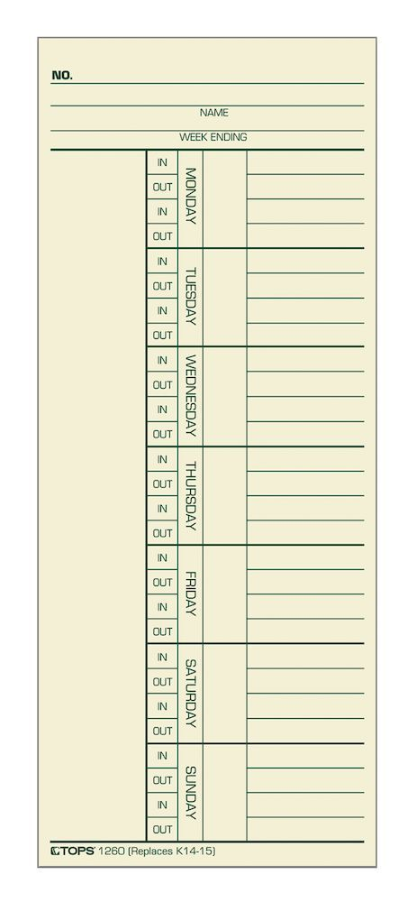
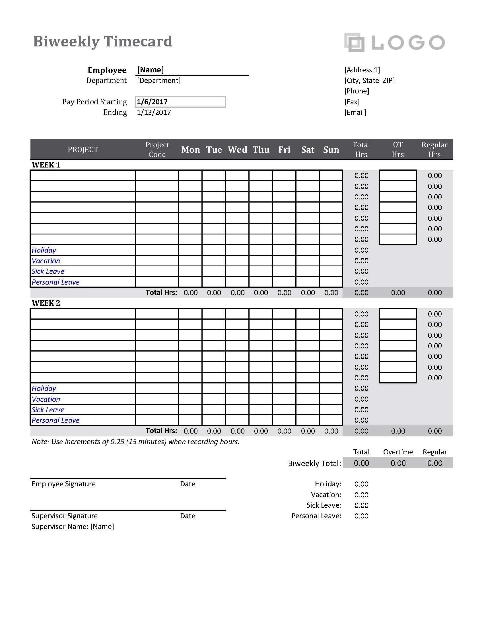

Slide 73
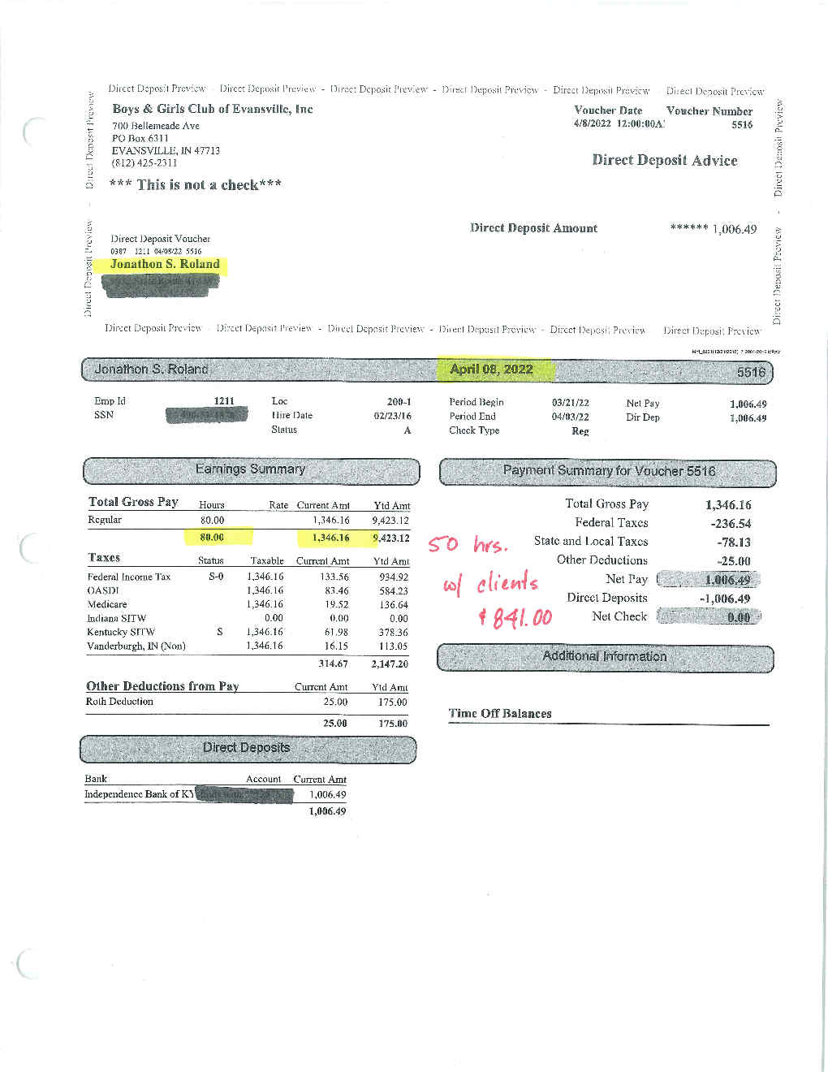
Claim Packet-
Example of actual Payroll claim submission
A

Slide 74
EXAMPLE OF CLAIM PACKET
Proof of Funds Expended
Copies of Cancelled Checks front and back OR
Copy of Bank Statement-Must include 1st page with agency name legible. Cancelled check or ACH withdrawal highlighted
If expense is paid by Credit Card, a copy of credit card statement and cancelled check paying credit card bill are required.
Please label check or ACH entry with the assigned identifier.
**Redact any non-public information-ex. Social Security Numbers, Date of Birth, Addresses of Employees

Slide 75
COMMON ISSUES WITH CLAIM SUBMISSIONS
Insufficient Monthly Monitoring Reporting (MMR) to back-up claim submissions. We must have record of grant accomplishments in order to pay claims
Documentation is insufficient for approval - make sure all source documentation for eligible expenses is included in submission. (ex. PO, Agency Inv, Vendor Inv, Payroll Reports and time cards, cancelled checks, credit card statements with proof of payment, and bank statements)
Ineligible Expenses – Only items listed in your SUBMITTED & APPROVED Budget are eligible for reimbursement. Application fees, late fees, finance charges, sales taxes for non-profits are NOT eligible for reimbursement.
Confidential information NOT REDACTED – ex. Birthdates, Social Security numbers, employee addresses, & bank account numbers

Slide 76
COMMON ISSUES WITH CLAIM SUBMISSIONS-Cont.
Documentation not in a logical order based on the Operating Agency Invoice Form and Summary Sheet. All source docs must be in the order of summary sheets so that it can be quickly and easily verified by multiple people as the claim packet moves through the approval process.
Claim submissions DOUBLE-SIDED – Single-sided copies ONLY.
Claim submissions STAPLED – DO NOT STAPLE documents; All docs are digitized before processing.

Slide 77
Monthly MONITORING reports
Monthly Monitoring Reports are critical in the grant award process.
In order to be in compliance with HUD regulation, CD Staff must input all collected monitoring data in the Integrated Disbursement and Information System (IDIS) from the Monthly Monitoring Reports received.
While the IDIS system is the basis for requesting funds from HUD, it is also the reporting mechanism to Congress on the accomplishments of HUD grant funds.
Future grant award amounts are affected by the information entered into IDIS.

Slide 78
Timeliness
60 days prior to end of each program year, the total CDBG funds available must be less that 1.5 times the current year grant amount
Priority will be given to subrecipients that have been timely
All activities proposed should be accomplished in 1 year
Proposals must be specific and include a timeline
Claim submissions should include all required documentation and be accurate to reduce processing time

Slide 79
Any agency that receives a federal grant has REQUIRED RECONCILIATION RESPONSIBILITIES
Agencies must maintain spreadsheets that reconcile all Grant Activities, updated upon each invoice submission.
This should include an accounting of the amount of funds granted, amount of funds claimed, and remaining balance of grant funds available to claim.

Slide 80
audits
All Non-federal entities that expend $750,000 or more of federal funds annually are required to obtain an annual audit
Grantees & Sub-recipients must adhere to Omni Circular Part 200 Subpart F – Audit Requirements.
When any Audit is performed, a copy of said Audit must be forwarded to your CD Specialist upon completion.
PLEASE ADVISE YOUR AUDITOR OF THESE REQUIREMENTS

Slide 81
Wrap-up
Make sure you have a Handout:
HOW TO PROPERLY SUBMIT INVOICES FOR REIMBURSEMENT
Good News! Additional Review of the Claims Submissions Processes can be available when Contracts are signed. Please let CD Staff know if you need to take advantage of this opportunity.
When in doubt contact your Community Development Specialist
REMINDER: New HUD guidance and a continuous review of internal policies may cause claim procedures to change at any given time.
Lisa C. Smith
email: lismith@evansville.in.gov
Phone: 812-436-7807

Slide 82
This Photo by Unknown Author is licensed under CC BY

Slide 83
HUD Allocations CDBG and ESG
Timeline (ONGOING)
ESG Overview
Proposals
CDBG Overview
Financial Responsibility
Monthly Monitoring Reports

Slide 84
MONTHLY MONITORING REPORTS
CDBG MONTHLY MONITORING REPORTS-DUE MONTHLY!
HMIS where applicable
There are (3) versions of the CDBG Monthly Monitoring Report which will be provided once project has been funded.
Limited clientele – Presumed Category Data
Limited clientele – Client Income Data
Limited clientele-Nature and Location

Slide 85
PRESUMED CATEGORY
MONITORING REPORTS
The Monthly Monitoring Report for Presumed Category Programs contains tracking information as defined by HUD.
HUD Defined Presumed Category | Monthly | Yearly
Abused Children
Battered Spouses
Disabled Adults
Homeless Persons
Illiterate Adults
Persons with AIDS
Migrant Farm Workers
Elderly Centers
Other Elderly Services
Total*

Slide 86
CLIENT INCOME
MONITORING REPORTS
The Monthly Monitoring Report for Client Income defined Programs contains tracking information as defined by HUD.
Income level based on Area Median Income for new/unduplicated served | Monthly | Yearly
0-30%
31-50%
51-80%
81% +
Total* new/unduplicated served*

Slide 87
NATURE & LOCATION
MONITORING REPORTS
Only tracks client race and ethnicity
Race: | Monthly |  |  | Yearly
 | Hispanic | Not Hispanic | Total | Hispanic | Not Hispanic | Total
White
Black/African American
Asian
American Indian/Alaska Native
Native Hawaiian/ Other Pacific Islander
American Indian/Alaska Native & White
Asian & White
Black/African American & White
American Indian/Alaska Native & Black/African American
Other not listed above
Total*

Slide 88
DATA TRACKING TOOLS
The Monthly Monitoring Reports contains (2) additional data collections items:
1.) Does your agency keep a waiting list for this program? Yes, No or Not Applicable
If a waiting list is kept, how many individuals are listed?
2.) Does your agency deny service for any reason? Yes, No or Not Applicable
If denial has been issued, has formal notice been provided? Yes or No

Slide 89
PROGRAM MONITORING
(3) Potential Monitoring Steps
Risk Analysis
Remote Monitoring
On-Site Monitoring

Slide 90
Risk analysis
A Risk Analysis is conducted of all subrecipients prior to the end of each program year.
This is completed by the assigned CD Specialist and is a rating worksheet to evaluate the subrecipient’s performance over the course of the program to date.
If the total overall risk score is over the predetermined threshold, then an on-site monitoring is scheduled with the subrecipient.

Slide 91
Remote MONITORING
The CD Specialist is responsible for conducting Remote Monitoring for each program funded with CDBG funds.
Communication will be sent to each agency for each program with instructions to assist with the Remote Monitoring process.
Information is collected regarding the program performance, record keeping and documentation, financial information, program income, compliance, procurement and general organization information.
Based on the information provided by the agency, a determination will be made regarding the need for an On-site Monitoring visit.

Slide 92
onsite monitoring
The basic on‐site monitoring includes a tour of the program facilities as appropriate, an explanation of the services provided, discussions with program and administrative staff, and introduction to one or more actual beneficiaries, if possible.
Items covered during on-site monitoring will include:
Program Review
Financial Review
At least (3) Random Client files will be reviewed
Invoice Review
As a result of this visit, staff may determine whether an in‐depth review is needed for further clarification of one or more issues that arise during the on‐site visit.

Slide 93
Environmental Review
Restrictions on Obligating HUD and Non-HUD Funds Prior to Completion of the Environmental Review Process
Commitment of HUD or Non-HUD funds must not be made until the Part 58 environmental review process is completed. HUD regulations at §58.22 place limitations on activities pending environmental clearance. Neither a recipient nor any participant, including public or private nonprofit or for-profit entities, or any of their contractors, can commit HUD or non-HUD funds on an activity or project until HUD or the state has approved the recipient’s certified RROF. This ensures actions are not taken that would have an adverse environmental impact or limit the choice of reasonable alternatives.
Never begin demolition or any construction related activity until the Notice to Proceed is issued. (when in doubt, ask first!)

Slide 94
Questions?
Presentation will be made available on City Website

